Slide 1


Asbestos Analyst Guide
UKATA Meeting
4 July 2019
Dr Martin Gibson
HSE

Slide 2
Aims of Session
New Analyst Guide
  To bring you up-to-date with final version of the Guide
  Consolidate/re-emphasise main changes
  Highlight some of the more subtle changes of the last year
Time scale

Slide 3

Analyst Programme Inspection Report
Completed (November 2018)
Underpins many of the changes in the Analyst Guide

Slide 4
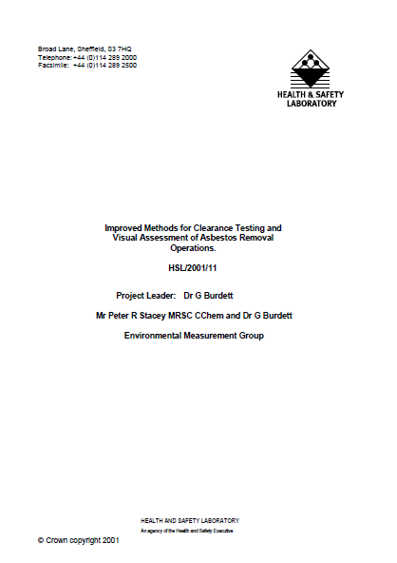
HSL Report: Published 2001
“Improved methods for clearance testing and visual assessment of asbestos removal operations”

Slide 5
Comparison of Findings
(2001 and 2015)
Analyst Inspection Programme (2015)
Time pressures and resources
Analyst Independence
Specific on–site issues
  Analyst cleaning up
  No clarity on extent of cleaning before failing
  Brushes not used
  Insufficient time taken to count slides
  Unshaven analysts
  No progressive and systematic visual inspections
  DCU checks not carried out
  Waste routes not challenged
HSL Report (2001)
Time pressures and resources
Analyst Independence
Specific on–site issues
  Analyst cleaning up
  No clarity on extent of cleaning before failing
  Brushes not used
  Insufficient time taken to count slides
  Unshaven analysts
  No progressive and systematic visual inspections
  DCU checks not carried out

Slide 6
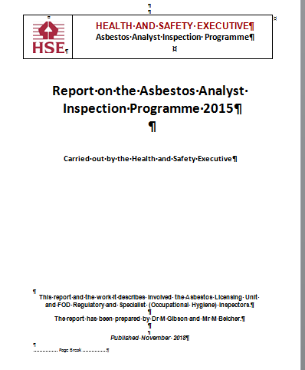
Other Findings and Issues (2015 Study)
Training/QC
PPE/Decontamination procedures
Job contract/scoping
Personal sampling
Current asbestos removals: A significant number of notifications are re-cleans!!

Slide 7

New Analyst Guide: Overview
Seeks to address issues identified in Analyst Inspection Programme and other issues
  More robust procedures
Anticipates changes to Licensed Contractors’ Guide
Same target audiences
Scope widened
  Soils
  New home for relevant methods
    Water Absorption Test from old L128 ACOP
    Discriminatory technique MDHS 87
Updates legal references
  Updated in line with CAR2012, ACOP L143, Surveyors Guide and other legislation
  Deletion of out-of-date references eg Action Levels

Slide 8
New Analyst Guide: Headlines
Improved scoping/contract arrangements
Better standard of licensed contractor cleaning
More robust and evidence based 4SC procedures
Stronger impartiality requirements
Greater quality control of analyst work
Various other changes and improvements

Slide 9
Scoping/Contract Arrangements
Analyst to be involved in scoping of work to enable:
  Adequate planning
  Sufficient clarity in 4SC requirements/allocation of resources
  Preparation of RA and POW
Achieved by:
  Pre-removal site visit
  Copy of LC’s POW
  Sufficient detail on nature of the work
Formal contract under CDM:
  LC has legal duties to cooperate with analyst
  Provide analyst with adequate information in timely manner

Slide 10
Implications of Analysts Cleaning during 4SC
Residual material/dust still in enclosures at 4SC
  Risk higher for Analysts
Operatives have failed to clean up
Supervisor has failed to thoroughly inspect
Analysts potentially carrying out licensed work
Licensed Contractor’s actions potentially responsible for Analysts causing breach of legislation (Section 36 HSWA)

Slide 11
Need for a Robust and Evidence-based 4SC Process
New monitoring and managing procedures for asbestos removal work and 4SC:
Handover form
Visual inspection time to be specified in advance
4SC to be failed if “clean-up” time exceeded
Photographic evidence of conditions and completeness
Video recording (desirable)
Improved quality control/performance monitoring for Analysts

Slide 12
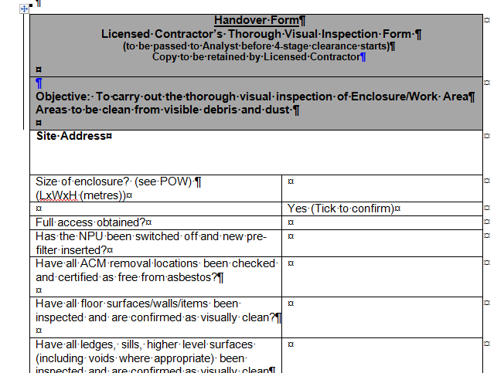
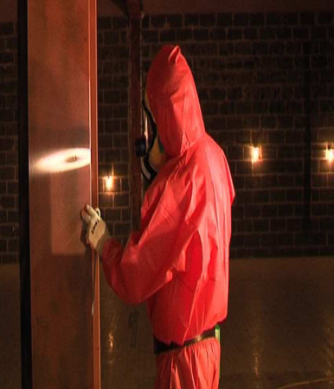
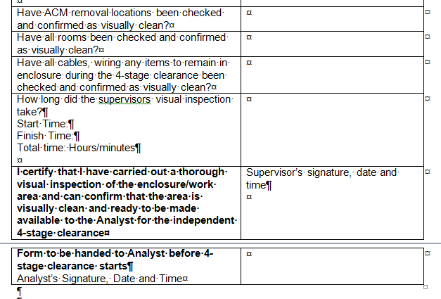
ACM removal locations checked?
Floors/surfaces/walls/ items checked
All rooms checked etc
Supervisor to sign to certify inspection completed
Analyst to sign as well

Slide 13
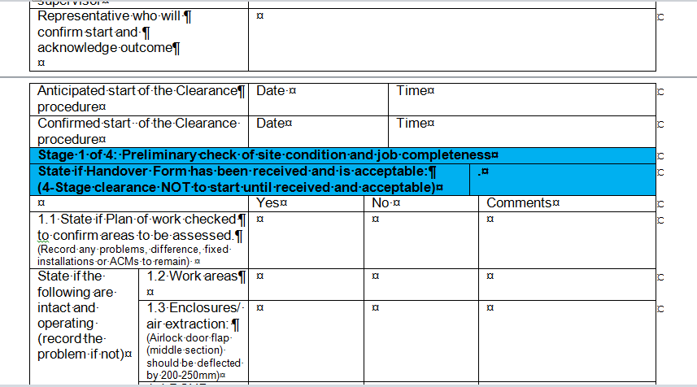
4SC: Certificate for Reoccupation has been modified for Handover Form

Slide 14
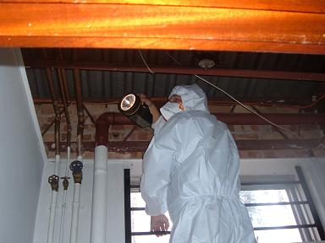
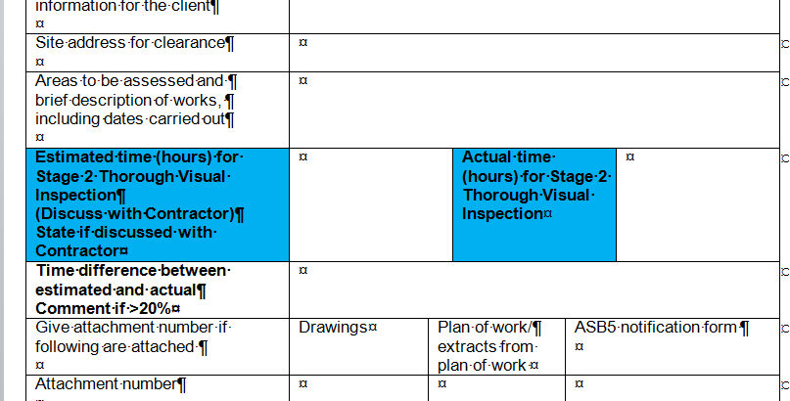
Analysts to estimate visual inspection time (Stage 2)
This makes commercial sense for Analyst
Process:
  Enter estimate into CfR
  Record how long 4SC takes
  Compare: If significantly different (>20%): explain
  Build up a data set of estimated/actual times
Notes:
14

Slide 15
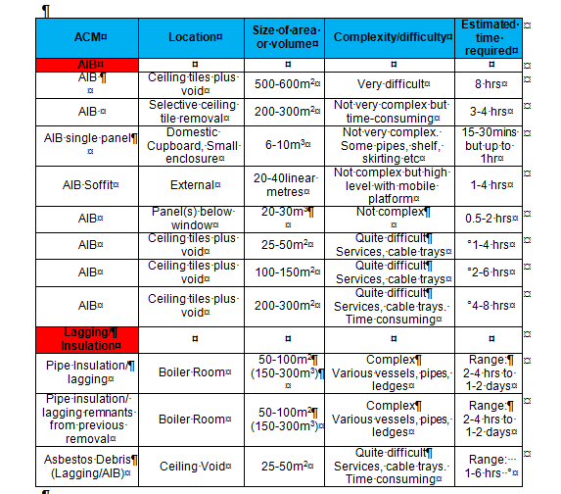
Establishing time for 4SC thorough visual inspection:
Use Table and knowledge/experience
Factors to consider (Illustrative list):
Room size, volume and layout
Room complexity
Extent of sheeting out
Items remaining
Voids (cabling)
High level surfaces
Ducting
Tunnels/cavities
Potential unforeseen situations

Slide 16

4SCs to be failed if significant cleaning required!
Analysts:
  Record if cleaning is required
  Cleaning to be carried out by LC
  If more than 10mins of further cleaning required:
    Job should be failed!

Slide 17
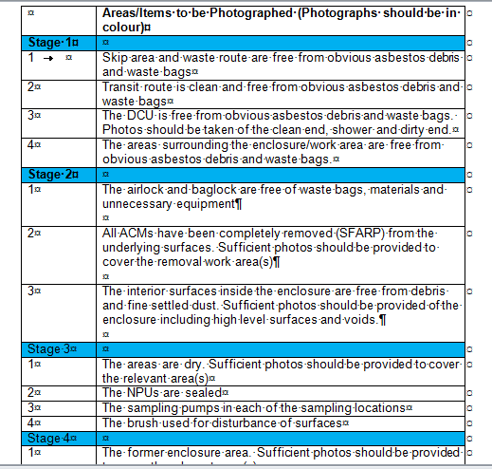
Evidence based clearance:
Photos expected in 4SC

Slide 18



Video Evidence for 4SC
Video evidence desirable
Video should cover key features of 4SC:
  transit and waste routes, external area around the enclosure, internal areas of the enclosure (airlock, baglock, enclosure sections etc), capped NPU, sampling pumps etc.
Video issued to client and LC

Slide 19

Analyst On-Site Performance
(Source: Analyst Inspection Programme)
Poor practices and standards for some analysts:
  Limited sampling
  No brushes or mirrors
  Insufficient time to count slides
  Unshaven
  Random inspection procedures
  DCU not checked
  Insufficient attention to transit and waste routes

Slide 20

Analyst Quality Control
Work should be continually assessed
Regular programme of on-site monitoring/auditing/re-inspection
  Guidance on site auditing protocol
Recommended that:
  ~5% of 4SCs audited/re-inspected
  Every Analyst audited/work re-inspected at least 4-times pa
Desk-top reviews of at least 5% of completed 4SC certificates

Slide 21
Analyst On-site Performance
Analysts also have individual responsibilities
HSW Act 1974: Section 7
  Places duties on employees to help protect not only other employees, but also any other person who might be affected by the employee’s actions or inactions.

Slide 22
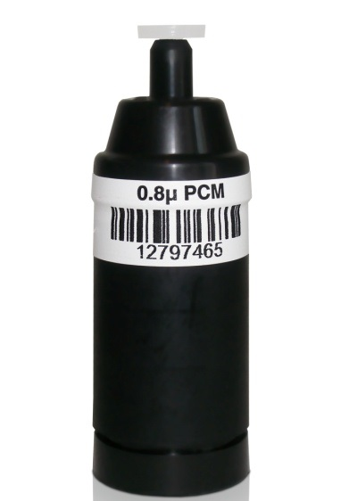
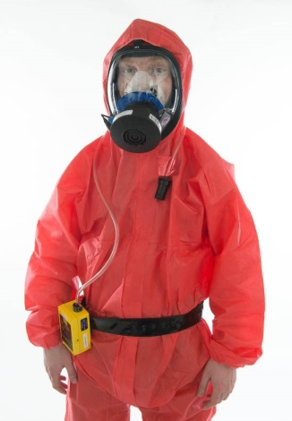
Personal Sampling of LCs:
Summary of Issues
Very short sampling periods
Only operator’s job title provided:
  No/minimum details of tasks and activities carried out
Low risk activities monitored
Virtually no exposure!!
Value of information??

Slide 23
Pause here:
Who is responsible for results/situation?
Contractor must be clear on purpose of sampling
Don’t just leave it to the Analyst
Should scrutinise results for:
  Quality
  Usefulness/value

Slide 24

Personal Sampling of LCs:
Improvements
Very specific information to be collected:
  Details of tasks and activities carried out
Long sampling periods
  2-3hrs/duration of shift
Information to be valuable!
  Comparison with Control Limit
  Analysis of tasks/asbestos types
  Analysis of personnel

Slide 25
Personal sampling of LAs:
Sampling Strategy
Should ensure representative range of work is sampled. Strategy should cover:
  A full range of work activities eg limpet, insulation, AIB etc
  A full range of geographical locations: capturing ‘close to home’ and more remote work sites
  All supervisors / teams
  Over time, sampling should capture exposures to all operatives across a full range of activities.

Slide 26
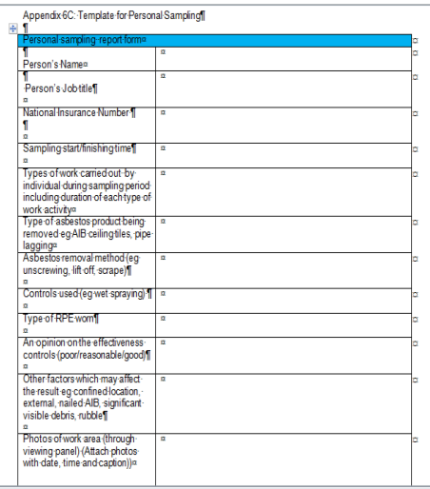
New Template for Personal Sampling Results (Appendix 6C)

Slide 27
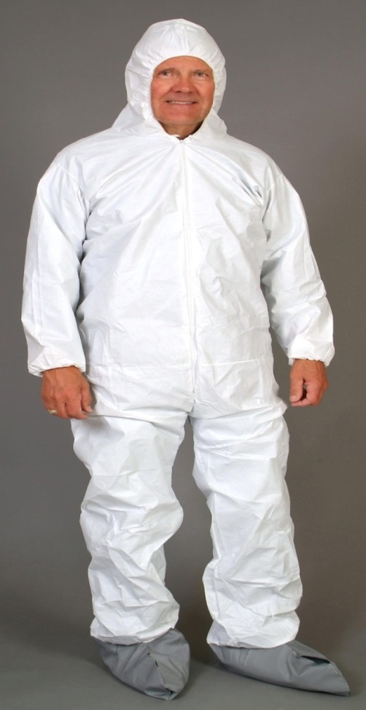
Analysts: Appropriate PPE:
4-Stage Clearance
Should be dressed to go thro full decontamination procedures
Should be set out in their written procedures
  Includes entry/exit for enclosure
Should not be wearing “own” clothes
Wear:
  Two sets of coveralls
  Disposable undergarments

Slide 28
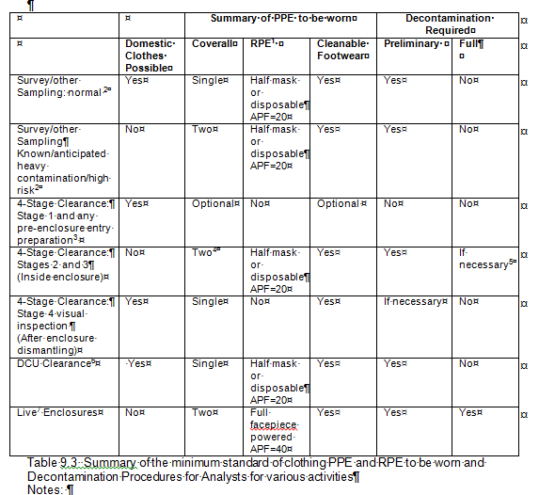
RPE/PPE and Decontamination for 4-stage clearance

Slide 29
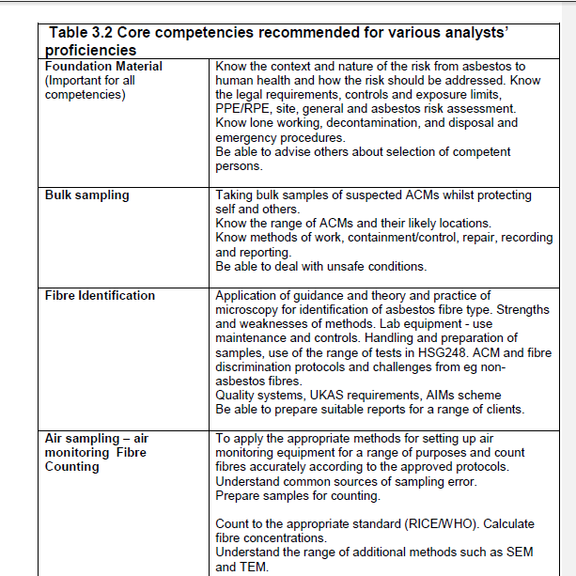
Analyst Competence/
Refresher Training
Refresher training in line with ACOP
Reflect training needs of individuals
  Identified in auditing
Reinforcement of good practice
  Personal sampling
  Decon procedures
Records kept

Slide 30
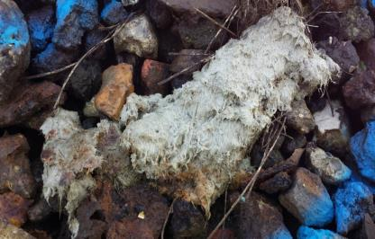
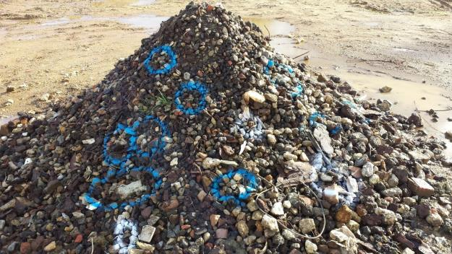
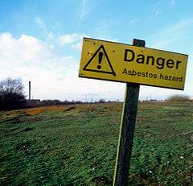
New Guidance for Asbestos in Soils and Made Ground
Two sections:
  Explanation of context and circumstances where soil sampling required to control the risk from asbestos
  Surveying and sampling methodology

Slide 31
Asbestos Soil/Made Ground
Surveys: CAR Context
Survey requirement only applies where land/site development is planned
  There is a work context
Soil survey expected where there is existing knowledge to suggest that asbestos may be present
  So no blanket requirement for soil sampling during site development
  Surveys not required under H&S legislation for environmental risk assessments or public health reasons

Slide 32
Soil Survey Types
Initial Investigation: Involves investigating the former use of the site and gathering information (desk-top study) on whether it is likely that asbestos was present or used on the site previously
Preliminary survey: Site walk over and limited surface/depth sampling
Main asbestos survey: Systematic surface/depth survey for visible and non-visible asbestos

Slide 33
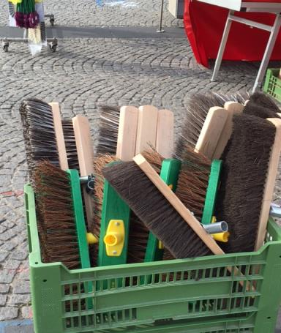
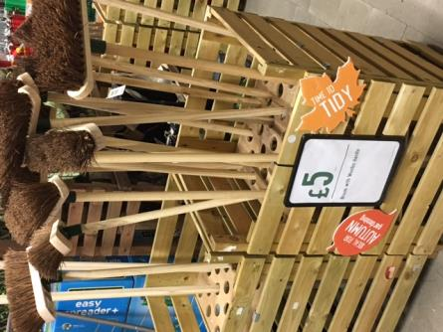
Don’t Forget:
New brush for every clearance!!

Slide 34
HSG248 Timescale/Programme 2019
Document to publishers (TSO)
(April)
Some further (minor) changes made
(May)
Resubmit to TSO (July)
Final document returned from TSO submit to PGG
Final HSE comments
(May)

