Slide 1
THERMAL RECYCLING
The way to eradicate asbestos

Slide 4
THERMAL RECYCLING
The way to eradicate asbestos

Slide 6
THERMAL RECYCLING
The way to eradicate asbestos

Slide 7
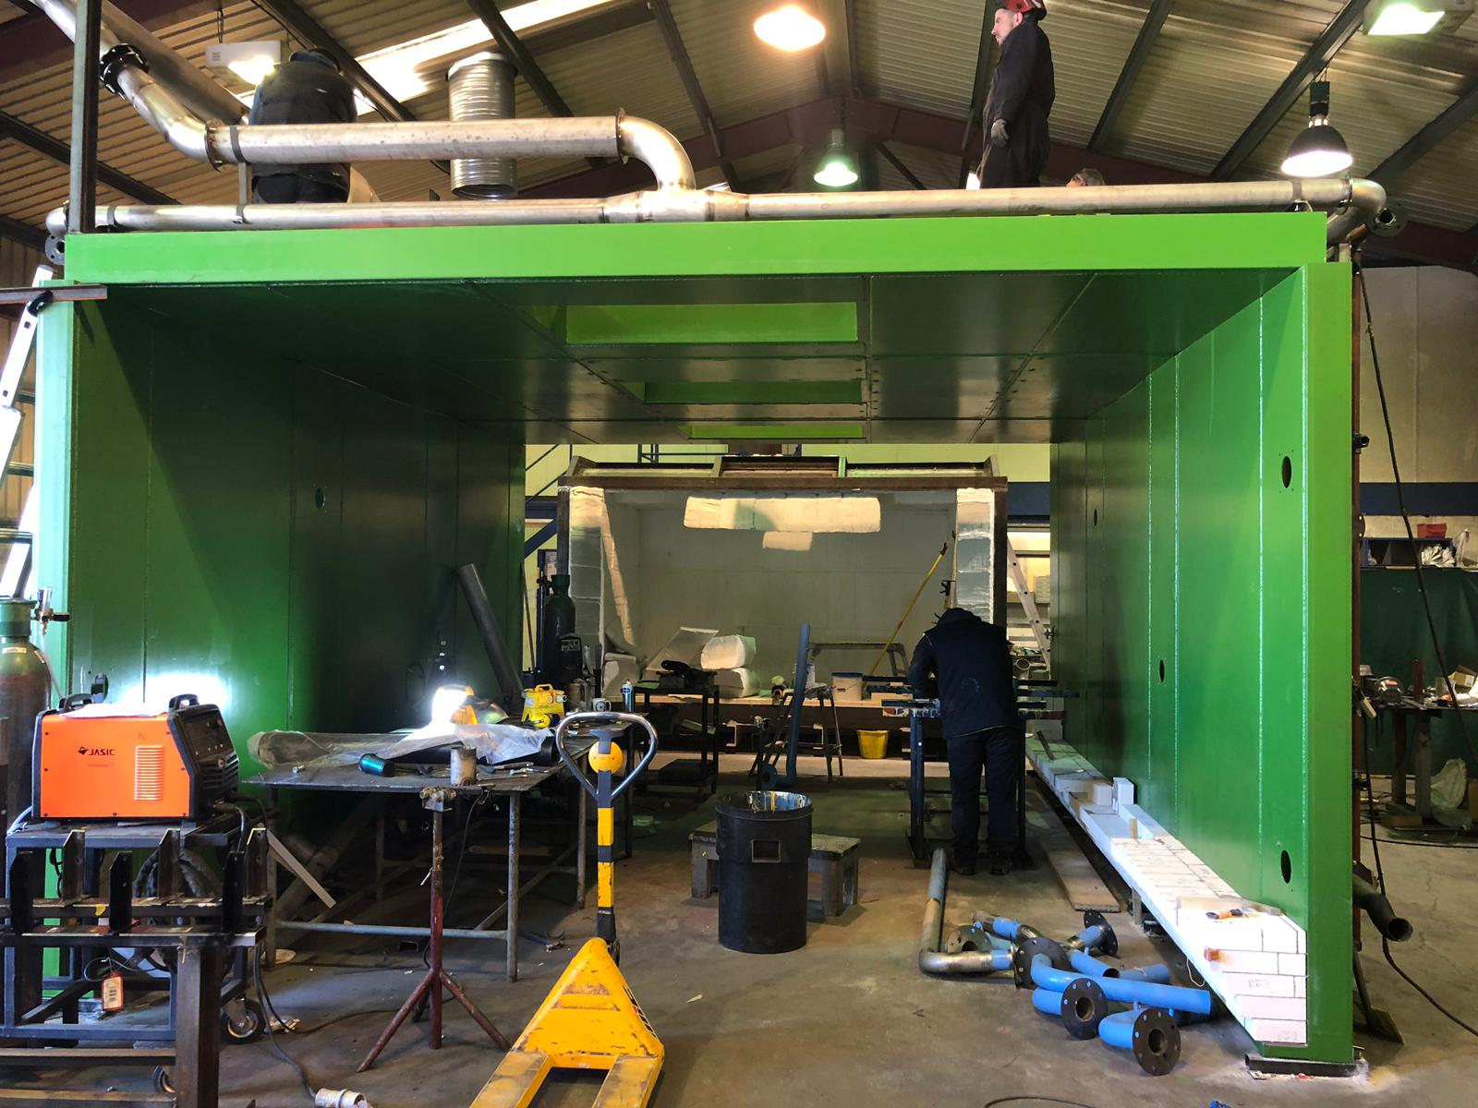
Kiln under construction

Slide 8
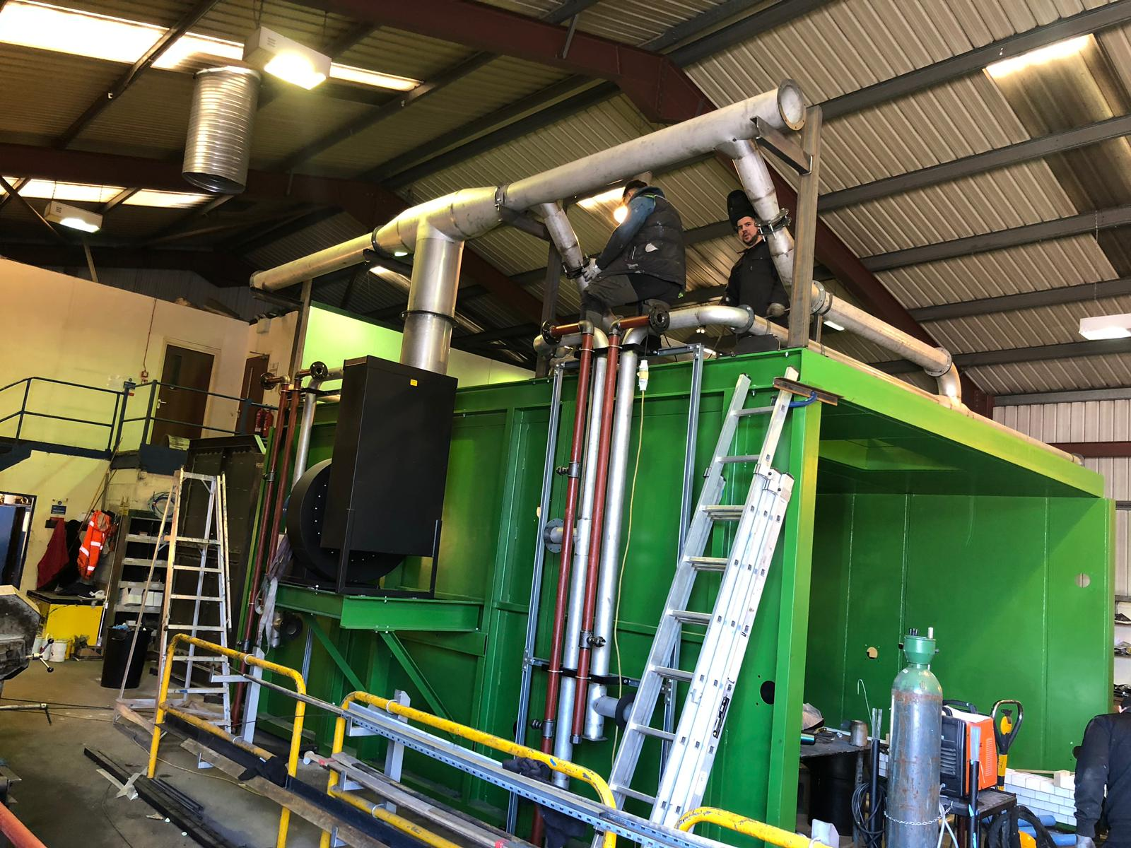
Kiln under construction

Slide 12
THERMAL RECYCLING
The way to eradicate asbestos

Slide 14
THERMAL RECYCLING
The way to eradicate asbestos

Slide 16
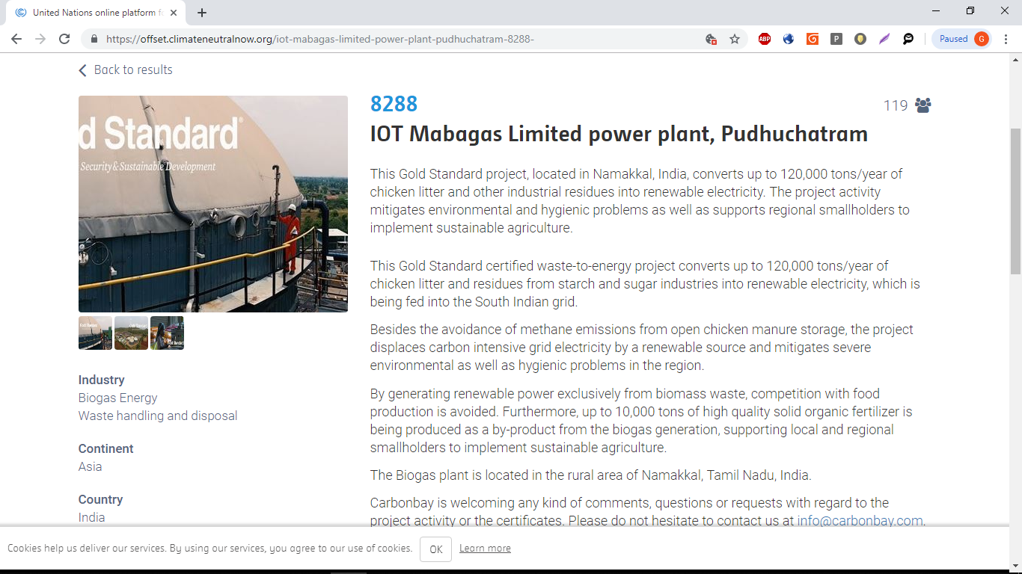

Slide 17
THERMAL RECYCLING
The way to eradicate asbestos

Slide 18
THERMAL RECYCLING
THANK YOU FOR LISTENING

