Slide 1
Mesothelioma research and the Mesothelioma Research Network (MRN) Cheryl Lenny

Slide 2
The British Lung Foundation
We’re the only UK charity looking after the nation’s lungs. We’ll make sure that one day everyone breathes clean air with healthy lungs.
HOPE
We've been researching lung conditions for 30 years. It’s still at the heart of what we do.
HELP
Our helpline, support groups, web community and easy-to-understand information offer vital hope and support.
A VOICE
We aim to prevent lung disease by campaigning for positive change in the UK's lung health and improve services for those with lung disease.

Slide 3
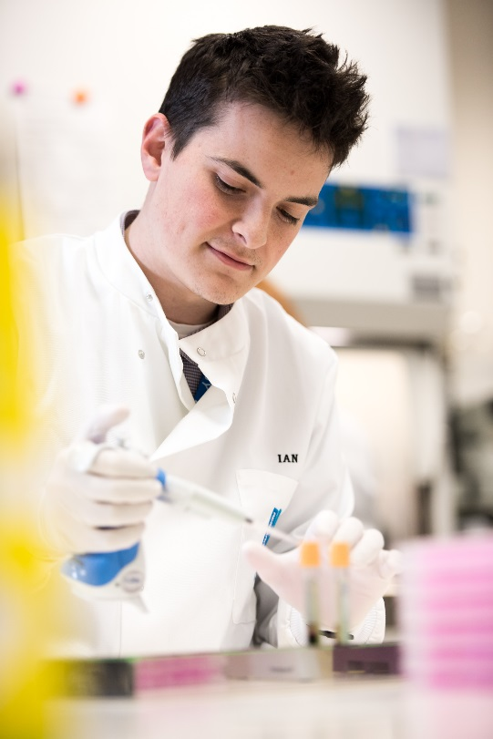
Why do we need more research?
Mesothelioma is a terminal condition.
Only 5% of men and 10% of women survive 5 years beyond diagnosis.^{[1]}
Research investment is low compared with other cancers that kill a similar amount of people.
We’re proud to have invested significantly in mesothelioma research.
But we need to do more and right now to give people with mesothelioma hope.
Web content: https://www.cancerresearchuk.org/about-cancer/mesothelioma/survival
Notes:
Most of you will know what mesothelioma is but for those that don’t, mesothelioma is a type of cancer that begins to grow in the lining around the lungs. It is usually caused by exposure to asbestos which people are in contact with during their working life. Sometimes people who live with those who have been exposed to mesothelioma develop disease.
At the moment outcomes for the disease are poor. The standard therapy that is approved for mesothelioma is chemotherapy which adds a couple of months to life at best. There are some people that have lived far longer, than the expected timeframe, often they have received new and innovative treatments provided by research, including clinical trials.
We need to offer something better for people affected by this dreadful disease.

Slide 4
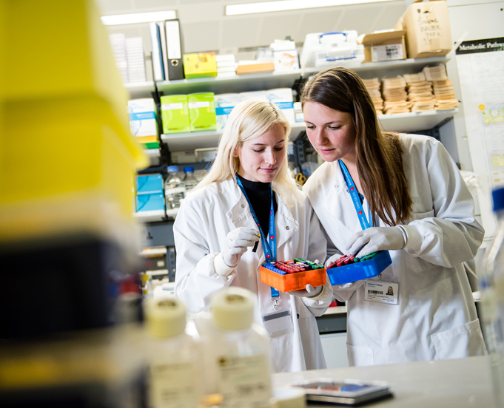
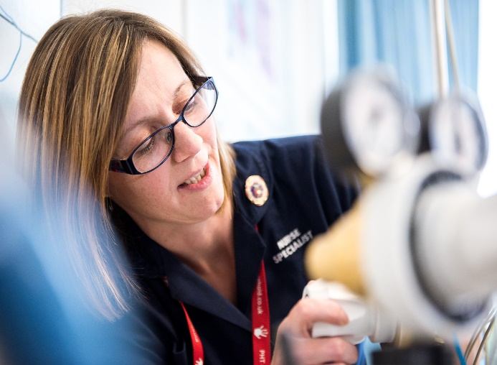
British Lung Foundation investment in mesothelioma research
BLF has invested £8.6 million in mesothelioma research, since 2002
48 projects to date: - 43 basic/translational science, disease mechanisms and moving great ideas towards the patient. - 5 clinical projects. Testing new ways of treating patients and new therapies.
Notes:
£8.5 million spent since 2002. Doesn’t account for all Victor Dahdaleh money as awarded on a yearly basis.
Clinical studies include:
Mesothelioma Stratified Therapy (MiST): A stratified multi-arm phase II clinical trial to enable accelerated evaluation of targeted therapies for relapsed malignant mesothelioma
Real time symptom assessment for patients with malignant pleural mesothelioma
A multicentre non-blinded randomised controlled trial to assess the impact of regular early specialist palliative care treatment on quality of life in malignant mesothelioma – ‘respect-meso’

Slide 5
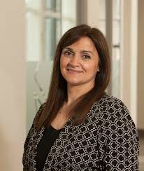
Recently completed research
Professor Roma Maguire, Strathclyde
Real time symptom assessment for patients with malignant pleural mesothelioma
Tested a mobile phone monitoring system for symptoms in people with mesothelioma.
Monitors patient symptoms, detects if any of the symptoms are of concern and alerts clinicians at the relevant hospital.
Clinicians review the patient’s symptoms and contact them at home to offer advice/reassurance.
The system proved acceptable and easy to use for patients, carers, and healthcare professionals.
Funding is being sought for a larger clinical trial.

Slide 6
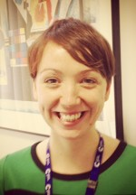
Recently completed research
Dr Sarah Martin, Barts Cancer Institute Overcoming resistance to arginine deprivation therapy in mesothelioma
50% of mesothelioma tumours lack a gene (ASS1) that allows them to synthesise arginine. ADI-PEG20, an arginine blocker, is being shown to be effective in trials but patients can become resistant to it.
This project has identified a number of enzymes that change when mesothelioma cells become resistant to ADI-PEG20.
The research team has worked out how cells eventually switch on the ASS1 gene to become resistant to ADI-PEG20.
They’ve found a drug, called GC7, that can be used in combination with ADI-PEG20 to eliminate the development of drug resistant cells.
Notes:
The problem
Our group has identified an Achilles’ heel whereby depriving the amino acid arginine selectively kills mesothelioma cells. This metabolic quirk of mesothelioma cells is due to loss of the enzyme ASS1, which makes arginine in otherwise healthy cells in our body.
Arginine is a highly versatile amino acid and is required for many important functions in the cell. About 50% of mesotheliomas do not express the ASS1 gene and therefore depend on a steady supply of arginine from the bloodstream for their growth and can be killed if arginine is suddenly removed. Arginine starvation can be achieved clinically with arginine blockers such as ADI-PEG20 and this has recently been tested in a multicentre clinical trial in patients across the UK. Significantly, this trial has achieved its primary endpoint of an improvement in progression free survival above the current standard of care. Although promising, recent data has shown that these tumours can become resistant to this therapy.
We have generated a number of cell models from different type of mesothelioma cells in the lab that mimic resistance to ADI-PEG20, in order to investigate what underlies the resistance and also to identify new ways of treating these tumours. We have analysed the molecules that change in mesothelioma cells when they become resistant to ADI-PEG20 and used drugs that target these molecules to understand whether we can kill drug-resistant cells.

Slide 7

Mesothelioma stratified therapy (MiST) trial
Designed by Professor Dean Fennell, Leicester.
Splits patients into groups based on characteristics of their tumour. Each group gets a tailored treatment.
For people that have had chemotherapy treatment, but it hasn’t worked/or stopped working.
Phase 2 trial – small numbers of patients in each group, to prove treatment effectiveness quickly.
ALL trial participants on active treatment.
Notes:
Led by Prof’s Dean Fennell and Anne Thomas in Leicester. TOTAL TO BE AWARDED: £2.35m over 5 years (2017-2021).
Molecular stratified – look at each patient’s tumour and picks out certain features. Based on these features patients are grouped into arms. Scientific evidence to suggest people in each group would respond to different therapies due to the molecular features of the tumour.

Slide 8
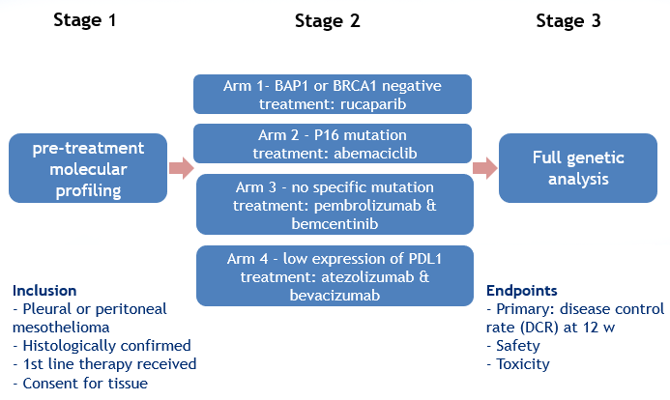
MiST trial design
Notes:
Open
Leicester
Scheduled to open Q2/3 2019
Newcastle
Manchester
London (Marsden)
Southampton
Future Centres (resource dependent)
Glasgow
Cardiff
Bristol

Slide 9
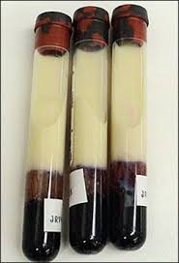
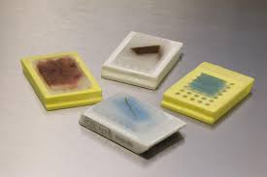
MesobanK
Mick Knighton Mesothelioma Tissue Bank
www.mesobank.com
The UK’s largest unique collection of high-quality samples from mesothelioma patients.
Researchers can apply for samples, accompanied by high-quality data, for their projects.
Originally funded by Mick Knighton Mesothelioma Research Fund, further funding has been awarded by the BLF thanks to a donation from the Victor Dahdaleh Foundation.
Notes:
TOTAL TO BE AWARDED: £2.35m over 5 years (2017-2021).
Alongside MesobanK running costs, the grant is also funding mesothelioma training fellowships for early stage laboratory and clinical researchers. One BLF-MesobanK mesothelioma fellowship is already underway looking at gold nanotubes as a way to treat mesothelioma.

Slide 10
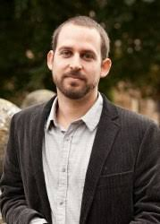
Recently funded research 2017
Genes in cages: design of smart capsules for the
delivery of macromolecules
Dr David Fairen-Jimenez, Cambridge
There is a need for more effective drug delivery systems (DDSs) in mesothelioma.
Recently, small nanocapsules made of porous materials (called MOFs), have been proposed as DDSs.
Researchers will develop a DDS using MOFs that are coated with antibodies on their outside (specifically targeting mesothelioma).
The research team aim to enhance the amount of drug in the DDSs and improve the control of drug delivery.
Notes:
Not exhaustive – just 2 examples from 2017
Dr David Fairen-Jimenez, Cambridge
Genes in cages: design of smart capsules for the delivery of macromolecules
Duration: 36 months Amount awarded: £108,447
There is a need for more effective drug delivery systems (DDSs) in mesothelioma that specifically recognise mesothelioma cells and stop them growing or kill them.
Recently, small nanocapsules made of porous materials (called MOFs), have been proposed as DDSs. In this project, the researchers will develop a DDS using MOFs
that are coated with antibodies on their outside, which means they will target mesothelioma cells to deliver the drug. The researchers aim to enhance the amount
of drug in the DDSs and improve the control of drug delivery. They will also test the new DDSs they develop on mesothelioma cells to assess their effect.

Slide 11
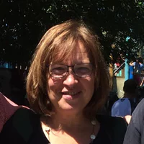
Recently funded research 2017
A novel screening method to find the best personalised immune therapy in mesothelioma
Dr Zsuzsanna Tabi, Cardiff Immunotherapy (IO) has shown promise alone and in combination in trials for lung cancer.
Dr Tabi is developing a laboratory method to identify genetic and immunological make up of tumours, using small pieces of patient tissue called ‘explants.’
The team will test a range of IO treatments alone and in combination on the explants.
They will complete screening of the tumour from 35 patients and find the most effective treatments for each. If effective a method like this could guide ‘personalised’ treatment selection.
Notes:
Dr Zsuzsanna Tabi, Cardiff
A novel screening method to find the best personalised immune therapy in mesothelioma
Duration: 36 months Amount awarded: £192,798
In this project, the research team will develop a laboratory-based method that will provide rapid information not only about the genetic but also the immunological
make-up of individual tumours. They will grow small pieces of tumour tissue from patients called ‘explants’ in the lab. They will then test a range of treatments alone
and in combination to maximise the effect of promising immunotherapies. This approach will provide information about what treatment combination is the most
successful in individuals with a certain genetic and immune tumour type, helping to guide personalised treatment in the future.

Slide 12
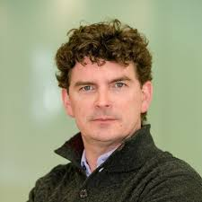
Recently funded research 2018
Engaging the immune system to fight mesothelioma
Dr Daniel Murphy, Glasgow Recent studies indicate macrophages (white blood cells) influence the immune response to cancer and may be involved in treatment resistance.
Dr Murphy’s team think that macrophage treatment may increase responses to standard chemotherapy and/or immunotherapy targeting PD-1.
Researchers will inject macrophage treatments (inhibitors) directly into the pleural cavity of mice with mesothelioma.
The team will then measure the effect of these treatments on the activity and death rate of the tumour cells.
Notes:
Not exhaustive – just 2 examples from 2018
Dr Daniel Murphy, Glasgow
Engaging the immune system to fight
mesothelioma
Duration: 36 months Amount awarded: £199,472
Immunotherapies have recently emerged as effective treatments for many cancers.
These drugs act by revealing previously hidden cancers to the immune system, or
by activating immune cells directly to fight cancer. For example, drugs that disrupt
the PD1 ‘immune checkpoint’ system have shown great promise, but only work in
around 20% of patients with mesothelioma. Macrophages are a kind of immune
cell. They play a crucial role in establishing the chronic inflammation in the lining
of the lung (pleura), which occurs before mesothelioma develops in most patients.
Once mesothelioma is established, macrophages remain important, and make up
20-30% of all the cells present in human mesothelioma tumours. Recent studies
also show that macrophages influence the immune response to cancer and may be
involved in resistance to standard treatments.
The research team anticipate that macrophage treatment may be effective as a
single agent and increase the number of responders to standard chemotherapy
and/or anti-PD1 immunotherapy. They have also developed a new, unique mouse
model of mesothelioma to test their theories. In this study, researchers will inject
macrophage treatments (CSF‐1R or CD98 inhibitors) directly into the pleural cavity
of mesothelioma-bearing mice. The team will then measure the effect of these
treatments on the activity and death rate of the tumour cells, and the length of
time the mice survive.

Slide 13

Recently funded research 2018
Improving the efficacy of standard-of-care chemotherapy in mesothelioma Dr Robert Ladner, Belfast Despite being standard-of-care, most mesotheliomas are resistant to chemotherapy.
The team discovered that a protein known as ‘dUTPase’ acts as a ‘gatekeeper’ to the cancer cell’s DNA.
The team will test dUTPase inhibitors in various simulated chemotherapy treatments to improve their understanding of how they protect a cancer cell’s DNA.
This could also enable them to identify patients who have the best chance of responding to dUTPase inhibitors in addition to chemotherapy.
Notes:
Dr Robert Ladner, Belfast
Improving the efficacy of standard-of-care chemotherapy in mesothelioma
Duration: 24 months Amount awarded: £185,498
One of the standard-of-care treatments for mesothelioma is pemetrexed, a
chemotherapy. When cancer cells are treated with pemetrexed or similar drugs,
they experience DNA damage that blocks their growth. Despite being standard-ofcare,
most mesotheliomas are resistant to these therapies.
The team discovered that a protein known as dUTPase acts as a ‘gatekeeper’ to the
cancer cell’s DNA, protecting the DNA during treatment. Cancers typically have a
high amount of dUTPase protein, giving the cancer cells a strong chance to survive
and eventually overcome treatment with chemotherapy. This research proposal
has one overarching goal: to provide scientific data to convince clinicians to direct
dUTPase inhibitors toward mesothelioma patients where they have the potential
to improve patient lives. To reach this goal, the team will test dUTPase inhibitors
in various simulated chemotherapy treatments to improve their understanding of
the vulnerability of mesotheliomas to these treatments. By analysing the cancer
cells’ molecular make-up, they will identify how this treatment kills mesothelioma
cells. This could also enable them to identify any markers of vulnerability that
may help select patients who have the best chance of responding to dUTPase
inhibitor treatment.

Slide 14
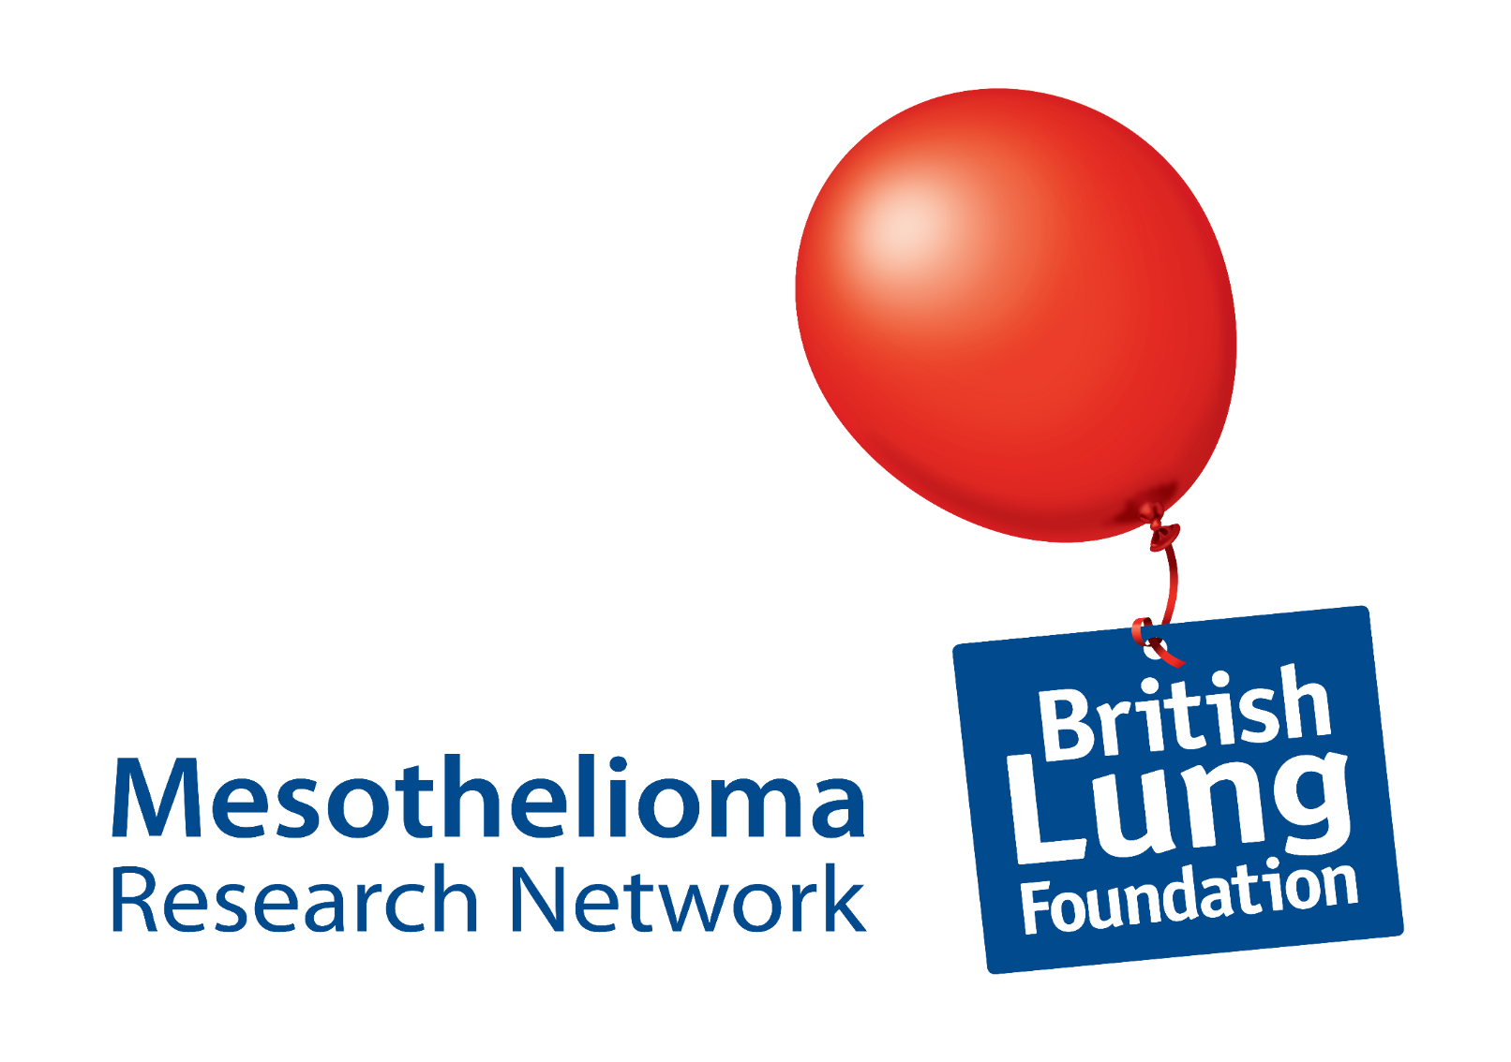

Slide 15



Why a research network?
Helping each other crack problems
Knowing what others are working on and not repeating research ‘unnecessarily.’
Improving the quality of research
Notes:
We know that we can speed progress in research up by bringing people working on the same thing together. There are many great examples of research networks across the globe making a real difference.
So why does sharing knowledge and research plans help things get done better and faster?
It may be there is a laboratory technique that one researcher has struggled with for months and yet another researcher has mastered this technique and can give guidance – saving time and money.
If 2 groups are working in the same research area we want them to at least know about it so they could help each other and make sure that the research adds value to what other teams are doing. If one group had found a negative result they could share this and if other groups repeat the work, suggest ways to improve it.
The aim of getting researchers to work together means that the quality of the research is better. Different people bring a different skills to a project. Learning from other disciplines like engineering can revolutionise the way we deliver treatments

Slide 16
What is the Mesothelioma Research Network (MRN)?
Launched in October 2017 after an extensive consultation exercise.
Connects mesothelioma researchers globally.
Includes laboratory researchers, as well healthcare professionals conducting or with an interest in research.
Enables sharing of:
knowledge
skills
resources.
The MRN stimulates research collaboration and maximises the resources currently invested in mesothelioma research.
Notes:
CONSULTATION: The design and offer of the MRN was informed by a consultation exercise with the research community. Including 16 qualitative interviews with the researchers and desk research
MEMBERSHIP:
The MRN will not include individual patients. The Steering Group has representation from three patient groups (see governance).
Organisations that support research can join as research support organisations (RSOs; one membership per organisation with a lead rep). Already RSO members: MRC, NIHR, Mesothelioma UK, June Hancock Mesothelioma Research Fund (JHMRF)
Researchers and HCPs join as individual members for FREE.
Aims of MRN
The aims of the MRN are to:
Bring researchers working in mesothelioma together to meet one another.
Help researchers share knowledge, skills and resources between them.
Help researchers to be in touch with what mesothelioma research is happening in the UK and globally.
To encourage research investment in mesothelioma.
To attract and retain the interest of researchers in this field.
Help avoid unnecessary duplication of research effort. [UNDER REVIEW]
Encourage collaboration, particularly in terms of applications to major funding bodies.
Encourage an ongoing conversation about mesothelioma research priorities to inform the strategies of the BLF and other funders.
Promote the MesobanK, a source of samples from patients, to researchers.
Activity of the MRN overseen by the MRNSG.
Decisions on which applications to fund is not made by the MRNSG. All of BLF’s mesothelioma funding will go through its usual competitive funding process.
MRNSG feed strategic recommendations for use of mesothelioma funding to be considered by the BLF and its Research Committee.
MRN-specific streams will still be competitive, but you must be an MRN member to apply.

Slide 17
Vision of the MRN
“Improve outcomes for people affected by mesothelioma by bringing together researchers, driving research progress and improving the quality of research carried out in the UK.”

Slide 18
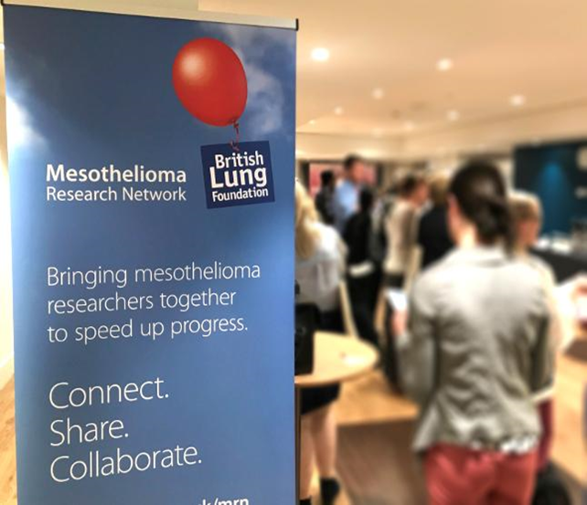
What benefits does the MRN offer?
Research funding.
An annual MRN Research Day (face-to-face meeting).
A monthly list of who is on the MRN, their skills, interests and resources to share.
MRN E-newsletter every 6 months.
Later in 2019
Webinars with research updates
A new networking platform for members.

Slide 19
How are we doing?
140+ members – both UK based and international.
In May 2018, 4 MRN members were financially supported to attend an international research conference.
We’ve held 2 MRN Research Days (2018/19). 2019 feedback is being processed but overall comments were very positive!
In the December 2018 members survey:
77% of responders felt that being a member of the MRN helped them in their work as a researcher.
95% would recommend being an MRN member to a colleague.
5 possible research collaborations had been formed.

Slide 20
Thank you
Any questions?

