Slide 1
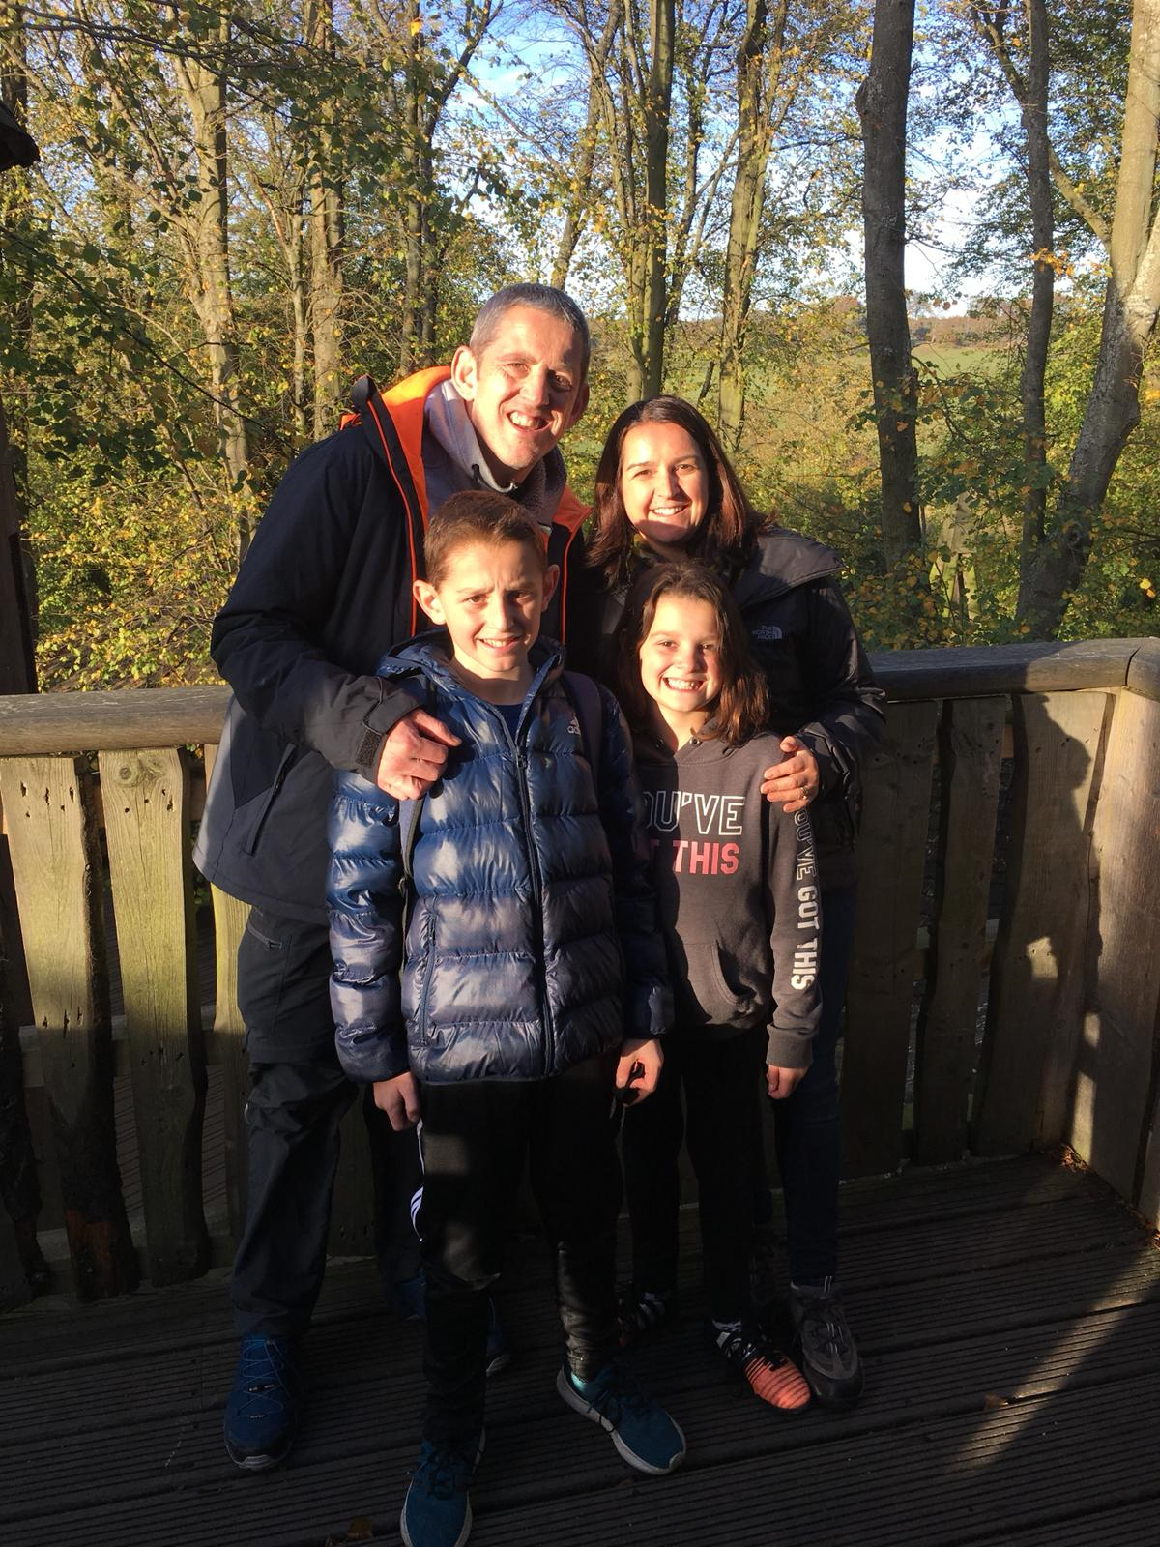
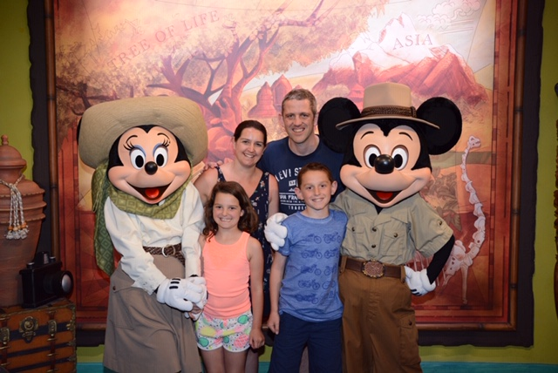
One Lung, One Life, One Hundred Miles!
David Staley
July 19

Slide 2
Our Meso Journey!
Symptoms – Pain In Back Left, Flu, Lack of Energy, Nightly Sweats
Pre- Diagnosis – CT Scans, 2 Biopsies, Not hitting markers
Diagnosis – Lives Changed Forever 29th Oct 2015 aged 39!
Start by doing what’s necessary; then do what’s possible; and suddenly you are doing the impossible” - Francis of Assisi
Start by doing what’s necessary:
Treatment – EPP – Left Lung Removal & Chemo
then do what’s possible :
Exercise – Personal Trainer, Macmillan Exercise Class & Pulmonary Rehab

Slide 3
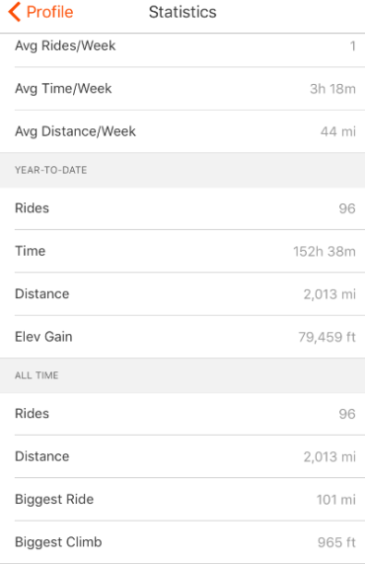
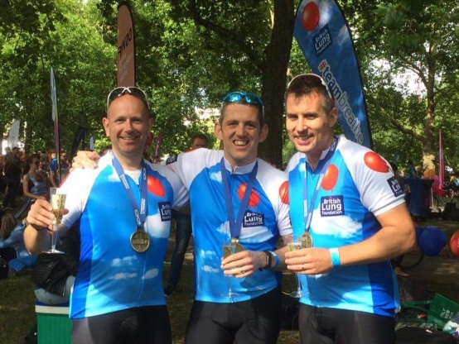
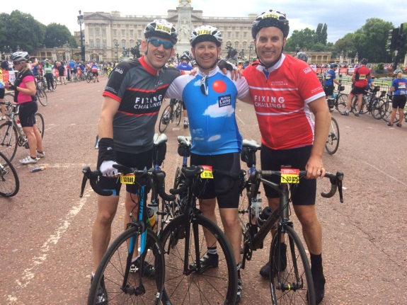
and suddenly you are doing the impossible”:
Cycling Challenge – London Ride 100 & Birmingham Velo
Raised £14000 for BLF & Meso UK
Today – Breathlessness; Fatigue; Posture/Back Injury; Keeping fit; Scan Anxiety and Work!
Tomorrow – Continue to raise awareness to help others and assist in fundraising to help find that cure!
Staleydavid@hotmail.com or https://davestaleyblog.wordpress.com
Start by doing what’s necessary; then do what’s possible; and suddenly you are doing the impossible” - Francis of Assisi

