Slide 1



Originally presented at the EAF,
Brussels, December 2024
GAZA the Latest Disaster
Prof Dr Roger Willey
C.E.O. ACS Risk
Board Member UKATA
A world leading authority on Asbestos and Physical Risk Management 1978
ACS Learning & Consultancy Ltd
Notes:
First slide

Slide 2
General Statement
I am NOT a politician.
I am NOT here to comment on the causes of the conflict or to apportion blame.
I am a humble scientist.
I am here to give you an indication of what is going to happen in Gaza if no action is taken.
www.acsrisk.com
Notes:
Example of Emma’s presentation slide

Slide 3
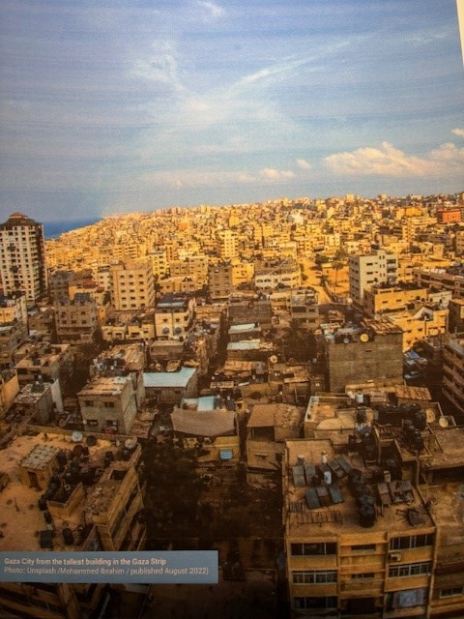
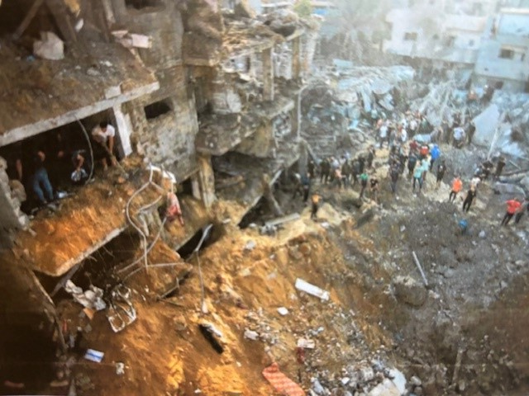
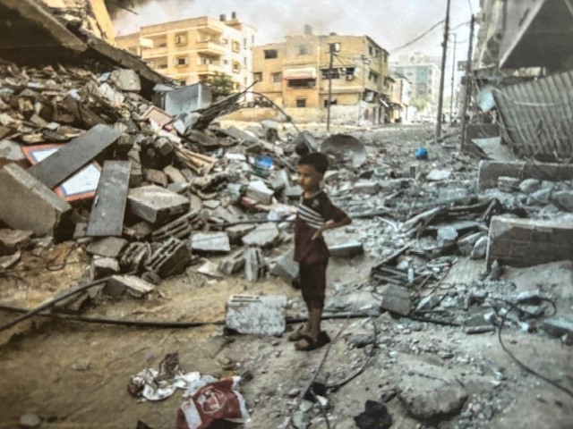
Current Gaza Conflict, Oct 2023
www.acsrisk.com
Notes:
Example of Emma’s presentation slide

Slide 4
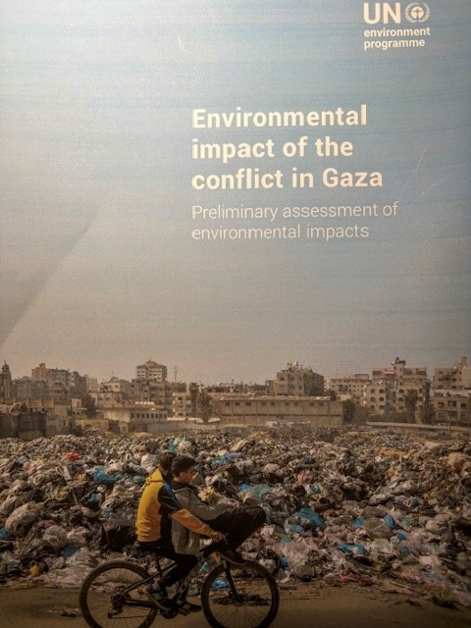
Preliminary UN report 2024
www.acsrisk.com
Notes:
Example of Emma’s presentation slide

Slide 5
UNEP Findings
Problems
Water, waste water, solid waste, sewage, armaments, etc.
Destruction of buildings and infrastructure.
Estimate for Gaza alone is 15,313,427 tonnes
www.acsrisk.com
Notes:
Example of Emma’s presentation slide

Slide 6
UNEP Findings 2009 & 2024
Post conflict assessment in 2009 in Gaza showed asbestos in building debris from roofs and walls of older buildings, building extensions, sheds and livestock facilities. Mostly asbestos cement, but crocidolite was found at some locations. (No details.)
In the 2024 assessment, an initial estimate from a rapid analysis of the eight refugee camps indicated that some 800 000 tonnes of debris may be contaminated with asbestos.
If it is assumed that most of the asbestos debris is asbestos cement this could mean that there is some 80 000 tonnes of asbestos fibres.
www.acsrisk.com
Notes:
Example of Emma’s presentation slide

Slide 7
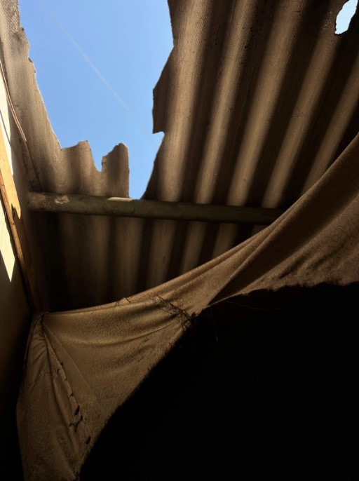
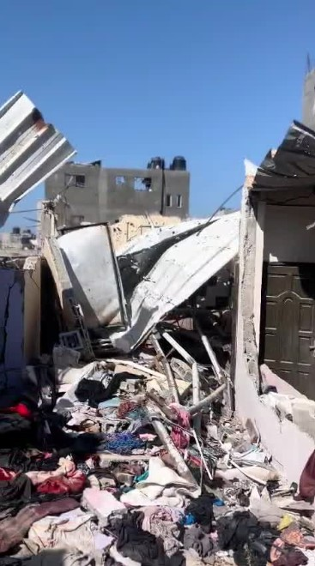
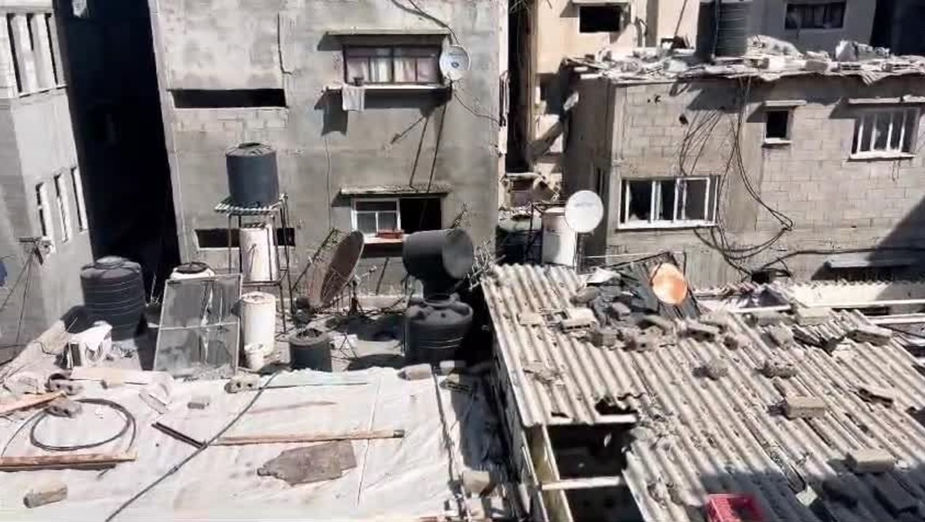
November 2024
(from a resident)
www.acsrisk.com
Notes:
Example of Emma’s presentation slide

Slide 8
More Figures on Gaza
Relatively small – 45km in length, 12-15 km in width.
2.2. million people
One of the highest population densities in the world.
Now made worse by people congregating in refugee camps.
Odds are that most of the population are now breathing in airborne asbestos fibres. (Hazard)
Is there a significant risk of Asbestos related diseases?
www.acsrisk.com
Notes:
Example of Emma’s presentation slide

Slide 9
The Helsinki Criteria
Scand. Journ. of Work Environmental Health (1977, 23, 311 – 316)
Best measure of occup. exposure is cumulative exposure
i.e what you breath in (f/ml) x how long (yrs) - unit is (f/ml).yrs
Review of cumulative exposures and subsequent deaths led to:
A cumulative exposure of > 25 (f/ml).yrs led to a doubling of
the risk of asbestosis or lung cancer.
A figure of 5 (f/ml).yrs has been associated with mesothelioma.
www.acsrisk.com
Notes:
Example of Emma’s presentation slide

Slide 10
An Example
Electrician drilling AIB horizontally, exposure is 2 f/ml (HSE)
(f/ml).yrs = 25 Thus yrs = 25 /(f/ml)
How long would the electrician have to work : yrs = 25/2 = 12.5 years.
After 12.5 years there would be enough fibres in the lung to generate asbestosis or lung cancer (albeit in 25 – 35 years time). A ticking time bomb.

Slide 11
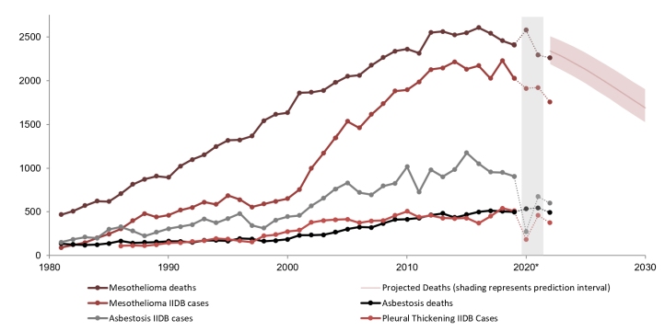
Mesothelioma, asbestosis, and pleural thickening: time trends in annual deaths and Industrial Injuries Disablement Benefit (IIDB) cases.
UKATA - Asbestos Health Statistics / updated 31/07/2024 (v7)

Slide 12
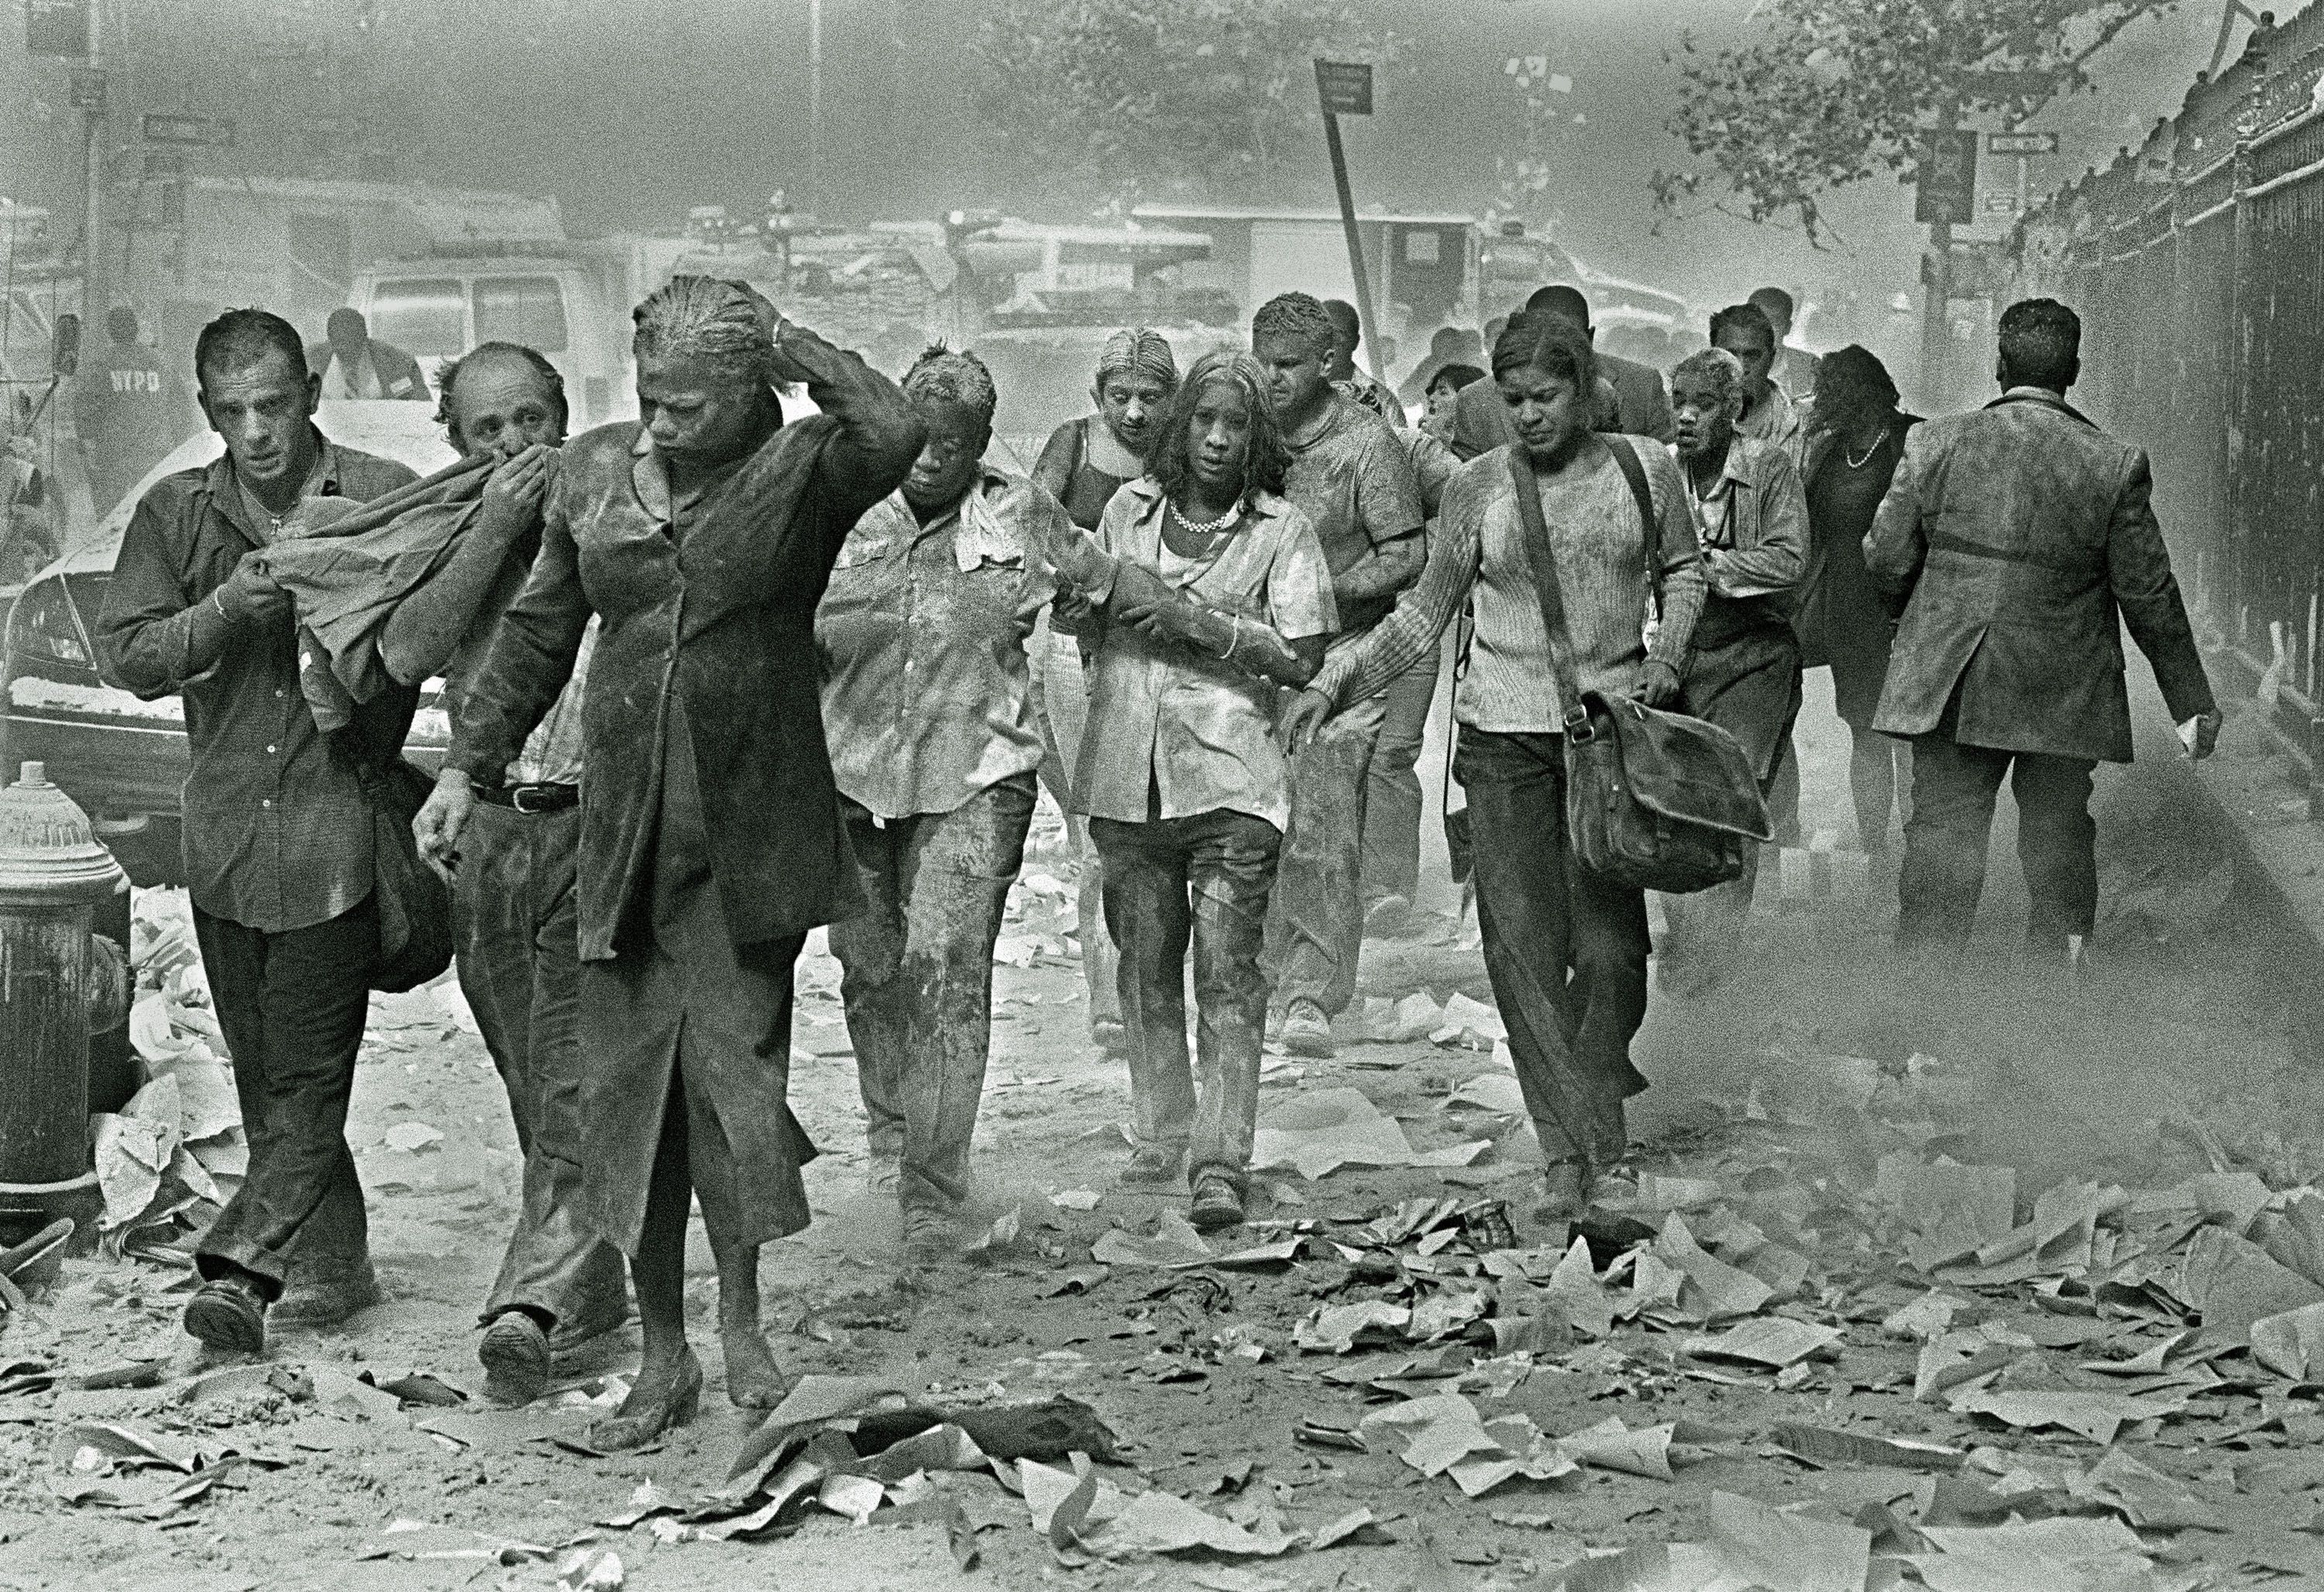
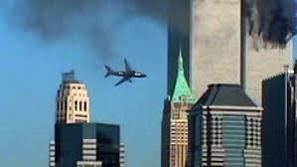
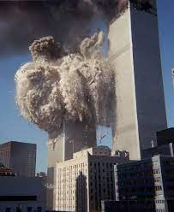
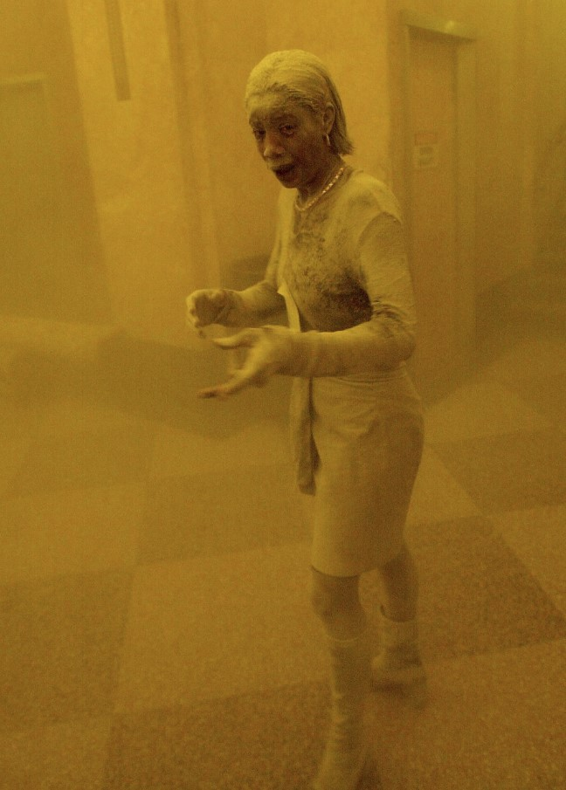
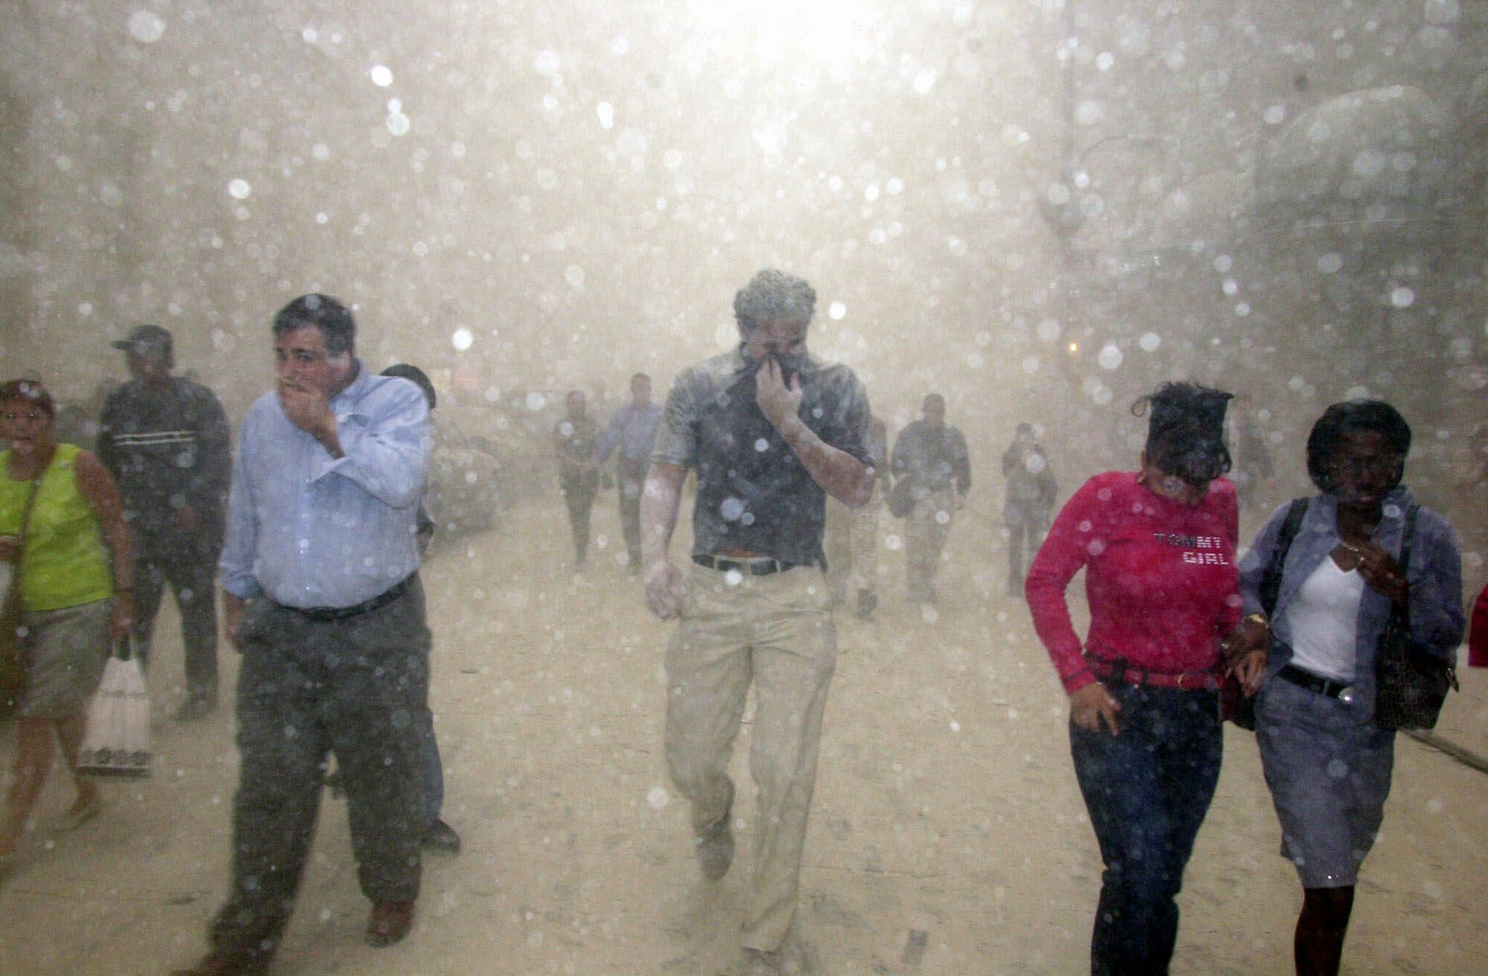
The Twin Towers
Probably about
1500 f/ml.
Limpet asbestos
sprayed on steel frames
www.acsrisk.com
Notes:
Example of Emma’s presentation slide

Slide 13
The Consequences of 9/11/2001
Killed in the attack 2996
US Centres for Disease Control & Prevention
Set up a W.T.C. Health Programme to monitor W.T.C. diseases.
Over 125 000 of 1st Responders & Survivors have long term effects,
mostly due to inhalation of asbestos fibres.
By 2023 over 5700 had died

Slide 14
Comparisons
WTC Gaza
Debris tonnes 1.8 m 15.3 m
Fibres released 2000 t 80 000 t
People exposed 410K – 525K possibly 1 – 2 m

Slide 15
The Twin Towers
Sprayed/limpet asbestos on steel structure of tower.
Removal of limpet by hand from ceilings of Glasgow Airport - 1000 f/ml (measured by ACS)
Estimate explosions caused even higher figure – estimate 1500 f/ml
How long for disease: Yrs = 25/1500 = 0.017 yrs = 6 days
Explains the very high number of asbestos deaths amongst first responders.

Slide 16
Apply same methodology to Gaza
Assume all material is asbestos cement (best case scenario).
Exposure from disturbed AC is some 10% of that from disturbed limpet asbestos. Assume exposure is 10% of 1500 = 150 f/ml.
How long (yrs) = 25/(f/ml) = 25/150 = 0.17 yr = 62 days.
The bombings started in October 2023, approx. 558 days to today

Slide 17
Another Important Factor is Age
A very large no. of refugees in the camps are children.
There is medical evidence that indicates that asbestos diseases increase as the time of exposure from birth decreases.
Doll & Peto, Effects on Health of Exposure to Asbestos, 1985
HSE Books, ISBN 0 7176 1075 6
This means that the risk to the children of Gaza is even higher than the risks on the previous slide.

Slide 18
Effect of Age at Exposure
Incidence of disease (L) at any time (t) L = k(time since 1st exposure)⁴
  Estimate L at age of 50 yrs
  Child Adult
  Born 2022 Born 1994
  Exposed 2024 (age 2) Exposed 2024(age 30)
  At age 50 2074 At age 50 2044
  L = k(2074 – 2024)⁴ L=k(2044 – 2024) ⁴
  L = k(6.25m) L = k(0.16m)
  L for the child is 39 times greater than for the Adult

Slide 19
Conclusion
We are looking at a nightmare scenario.
Far, far worse than the Twin Towers.
I am not sure that most people are even aware of the situation.

Slide 20
What can WE do?
Rapid Damage & Needs Assessment (RDNA) will be planned jointly by the UNEO, the World Bank and the European Union.
These people are not hands on asbestos people. They do not have practical backgrounds.
Most people at this conference are the complete opposite. Some of us have direct experience at moving large amounts of contaminated land & we have access to people in the USA and in New Zealand who have planned and carried out this type of work.

Slide 21
What can WE do?
UKATA and the European Asbestos Forum will be happy to put together a working group which would develop a protocol to assist the UNEP, the World Bank, the European Union and any other major bodies willing to assist in the reduction of asbestos risk in Gaza.
If you have the knowledge and experience, will you help me fulfil this vision?

Slide 22

Let’s keep in touch:
roger@acsrisk.com
Linkedin.com/in/rogerwilley
www.acswellbeing.co.uk
Notes:
Example of Emma’s presentation slide

Slide 23



Contact ACS
Head Office:
ACS Risk Group
Unit 14 Claremont Centre
Durham Street
G41 1BS
T: +44 (0)141 427 5171
F: +44 (0)141 427 2722
E: info@acrisk.com
W: www.acsrisk.com
A world leading authority on Asbestos and Physical Risk Management 1978
ACS Consultancy
Notes:
Example of Emma’s presentation slide

