Slide 1
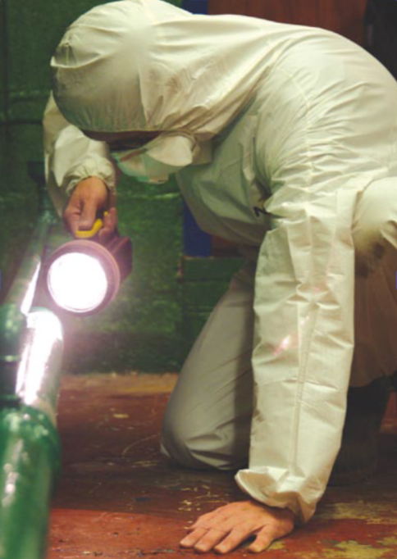
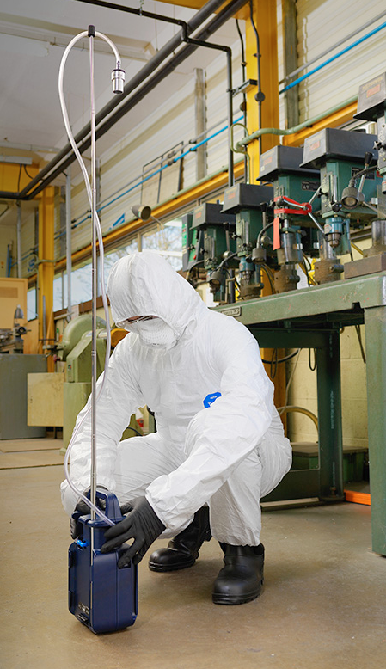
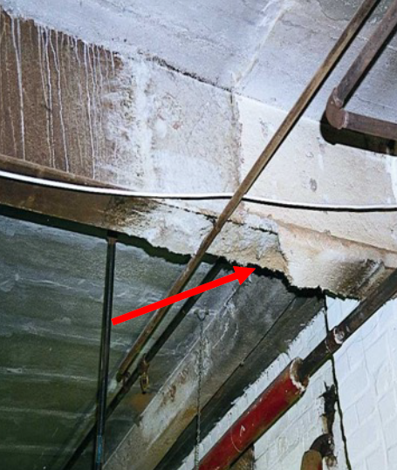
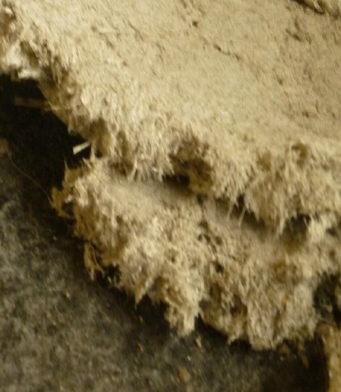
Asbestos monitoring, the benefits of new sampling pump technologies in how to keep people safe
Date: 28th November 2025 10am – 11 am (GMT)
By Stephen Sandford

Slide 2
Webinar outline
Essential principles and practicalities of asbestos air sampling
Why it remains critical for workplace and public safety
Health risks posed by inhaling airborne fibres
Strict legal requirements for licenced contractors to ensure safe removal and site clearance
Accurate sampling, correct equipment uses, and adherence to best practice
best practice guidance for effective asbestos monitoring and management.
Notes:
This presentation will outline the essential principles and practicalities of asbestos air sampling, focusing on why it remains critical for workplace and public safety. Asbestos monitoring is vital to protect workers and the public from the severe health risks posed by inhaling airborne fibres, which can cause fatal respiratory diseases. Monitoring involves both personal and static air sampling, with strict legal requirements for licenced contractors to ensure safe removal and site clearance. The four-stage clearance process of site checks, visual inspections, air monitoring, and a final assessment ensures fibre levels are below UK limits before reoccupation. Accurate sampling, correct equipment uses, and adherence to best practice are essential to minimise risk, prevent exposure, and ultimately save lives. By the end of this session, you will understand the key steps, legal obligations, and best practice guidance for effective asbestos monitoring and management.

Slide 3
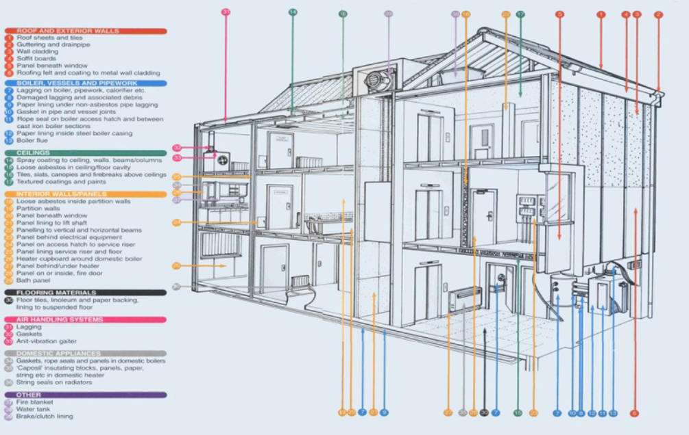
Eight Steps to Manage
1. Know where it is.
2. Record where it is.
3. Complete a risk assessment.
4. Create a management plan
5. Planning to work on asbestos- containing materials (ACMs).
6. Inform those who are potentially exposed.
7. Train workers.
8. Investigate asbestos incidents.
Notes:
Sprayed coatings: These can be found on ceilings, walls, beams, and columns, often used for insulation and fire protection.
Asbestos Insulating Board (AIB): Used for fireproofing, AIB can be found in ceiling tiles, partition walls, panels in fire doors, and around boilers.
Textured coatings: Commonly known as Artex, these coatings were used on walls and ceilings.
Lagging: Asbestos lagging was used to insulate pipes and boilers.
Vinyl floor tiles: These were a popular flooring option and may contain asbestos.
Water tanks: Asbestos cement was used for water tanks.
Acoustic tiles: Some older acoustic tiles used for soundproofing may contain asbestos.
Toilet seats and cisterns: These can also be made from asbestos-containing materials.
Outside the Building:
Roofing: Asbestos cement was commonly used for roofing and can be found in sheets and shingles.
Gutters and downpipes: Asbestos cement was a popular material for these.
Cladding: Asbestos cement panels were used for cladding buildings.
Flues: Asbestos cement flues were used in boiler systems

Slide 4
Risks
High Risk of Fibre Release:
Limpet Sprayed Coatings.
Thermal Insulation – Lagging to Pipes, Boilers and Calorifiers Insulating Boards.
Medium Risk of Fibre Release
Cement Products – Roof Sheets and Flues etc....
Woven Textiles – Fire Blankets and Curtains etc....
Paper Products.
Low Risk of Fibre Release :
Plastics – Thermoplastic Floor Tiles and Stair Nosings etc....
Bitumen Products – Roofing Felts etc....
Textured Coatings – Artex Decorative Coatings and Paints etc...
Others – Mastics, Sealants, Putties and Adhesives etc....
Notes:
Those involved in demolition work, asbestos abatement, building repair and maintenance may be exposed to higher levels of asbestos as disturbing such materials releases fibres into the air.

Slide 5
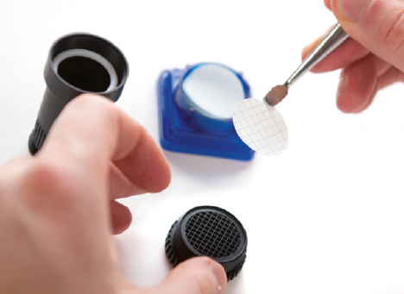
HSG248 – Air Sampling Principle
Collect sample on a filter (25mm Mixed Cellulose Ester (MCE) pore size 0.8um to 1.2um).
Draw measured volume of air.
Filter mounted on a microscope slide.
Filter rendered transparent.
Fibres of appropriate dimensions in a measured area are counted.
Number concentration of fibres in the air calculated.
Notes:
The air sampling principle used in HSG248 (Asbestos: The Analysts' Guide), published by the UK Health and Safety Executive (HSE), is based on drawing a known volume of air through a filter to collect airborne asbestos fibres, which are then counted under a microscope.
Here’s a summary of the key air sampling principles described in HSG248:
🔹 1. Sampling Method: Static or Personal Air Sampling
Static (fixed-point) sampling: Measures airborne asbestos concentrations in a specific area.
Personal sampling: Measures the exposure of a worker by placing the sampler in the breathing zone.
🔹 2. Sampling Equipment
Sampling pump: Maintains a calibrated and consistent flow rate (typically 1–2 L/min).
Filter cassette: Usually uses a 0.8 µm mixed cellulose ester (MCE) filter housed in a conductive cassette.
Support equipment: Flow calibrator, stopwatch, rotameter.
🔹 3. Sampling Principle
A calibrated air pump draws a known volume of air through the MCE filter, trapping airborne asbestos fibres.
The sample volume (V) is calculated as:
V=Flow rate (L/min)×Sampling time (min)V = \text{Flow rate (L/min)} \times \text{Sampling time (min)}V=Flow rate (L/min)×Sampling time (min)
🔹 4. Fibre Counting (Analysis)
The filter is cleared using acetone or triacetin and mounted on a slide.
Analysis is carried out using Phase Contrast Microscopy (PCM) according to the HSE method or WHO method.
Fibres are counted according to strict dimensional criteria (e.g., length > 5 µm, aspect ratio > 3:1).
🔹 5. Purpose of Sampling
Background testing
Leak testing (enclosures)
Clearance air monitoring
Reassurance testing
Personal exposure assessment
✅ Compliance with HSG248
Sampling and analysis must:
Follow quality control procedures
Be conducted by UKAS-accredited analysts
Use appropriate flow rates, durations, and detection limits

Slide 6
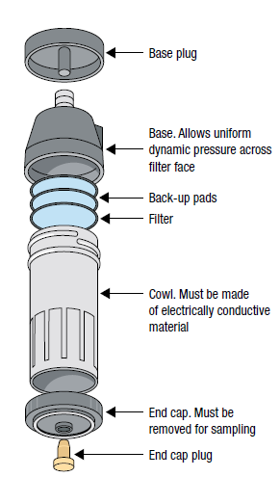
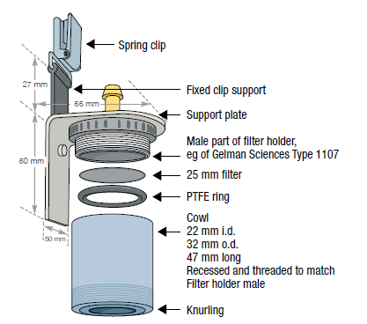
IOM Sampler
Conductive Cowl Sampling head
Personal Sampling
Point down.
Close to mouth (200mm).
Away from clean air exhaust.
Left or right handed.
Static Sampling
Size of enclosure.
Amount of dust.
Position depending on test.

Slide 7
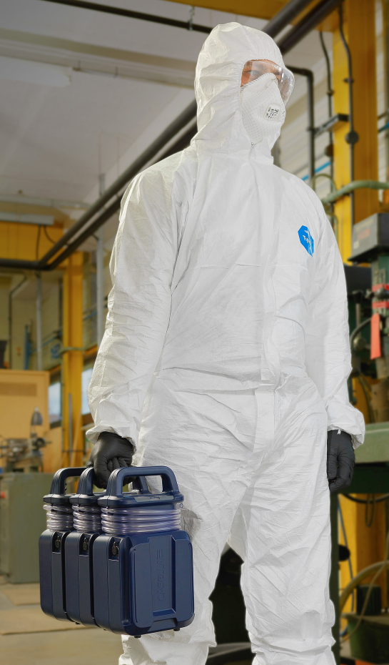
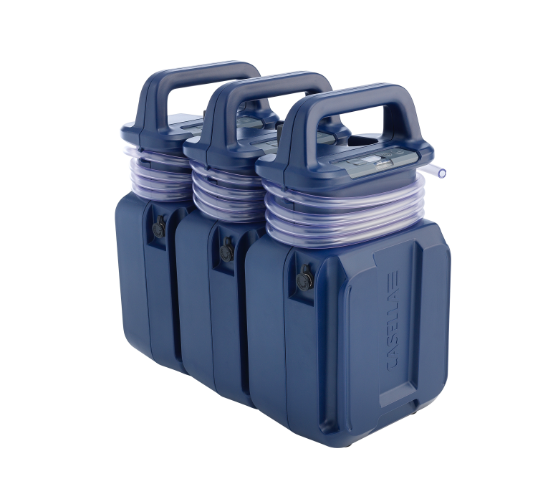
Pump Considerations
Transportation
Lightweight.
Easy to wear/carry.
Decontamination
Cleaning.
Repair.
Performance
Battery life.
Back pressure.
ISO 13137 Compliance.

Slide 8
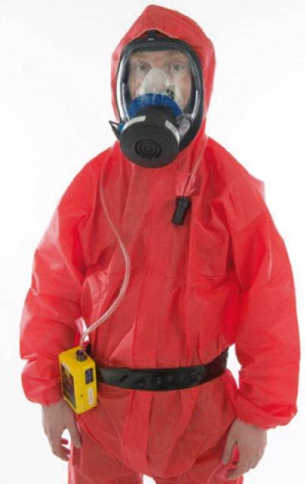
IOM Sampler
Personal Sampling
Check employee's exposure
Confirm the adequacy of controls and Respiratory Protection Equipment (RPE) (ie whether the RPE chosen provides the appropriate degree of protection).
Establish employee exposure records.
Support current and future risk assessments.
It should
Cover a range job range and methods.
Regular intervals.
Sample
Representative
Enclosure shift e.g 2-3 hours
Minimum sample of 10mins for Short Term Exposure Limit (STEL)
Sequential sampling in high dust environments

Slide 9
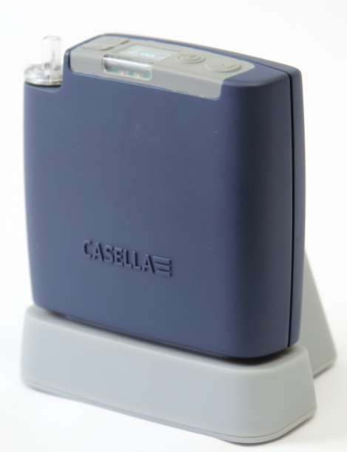
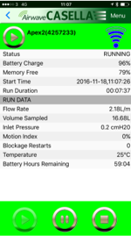
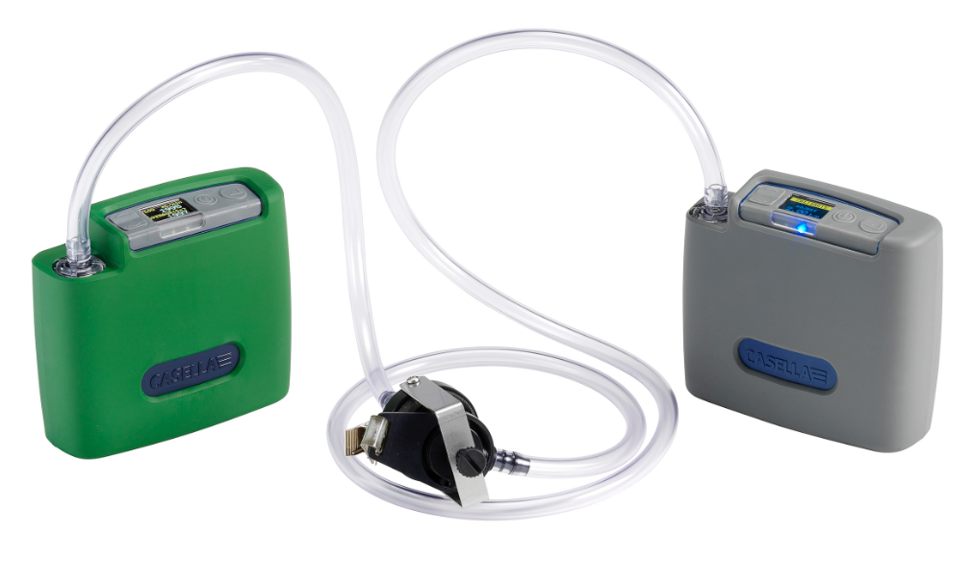
Apex2 (personal sampling Pump)
Class beating performance
Bluetooth® and Airwave App®
Wearer acceptance
Motion Sensing
All Models Intrinsically safe
Detailed Reporting
Easy Calibration

Slide 10
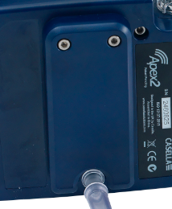
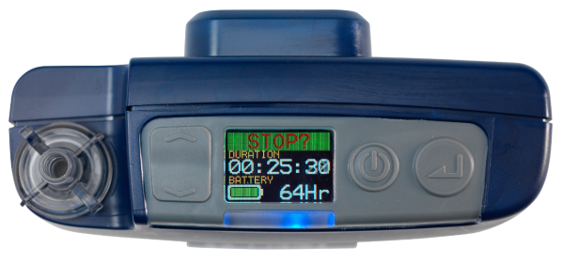
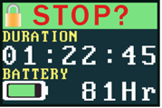
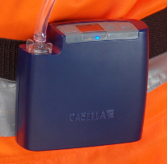

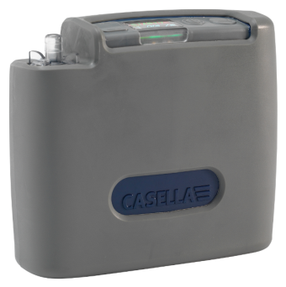
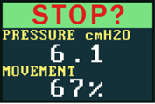
Apex 2 IS – High Wearer Acceptance
Good wearer acceptance means good quality exposure data
Sturdy Clip with a Lifetime Guarantee
The Thinnest Pump on the Market
Lockable Display and Keys
Flexible to Wear
Motion Detection
Rubber Boot for Protection
Notes:
Thinnest Pump on the Market, ergonomic and comfortable (<40mm) – wont take it off – Motion sensor
Flexible Wearing – for wearing on the hip, chest, back, in the pocket
Lockable Display and Keys – no tampering so wearer leaves it alone
Smooth finish for easy decontamination
Motion detector give % amount of time in motion, can set time interval it calculates over
Lightweight, only 480g

Slide 11
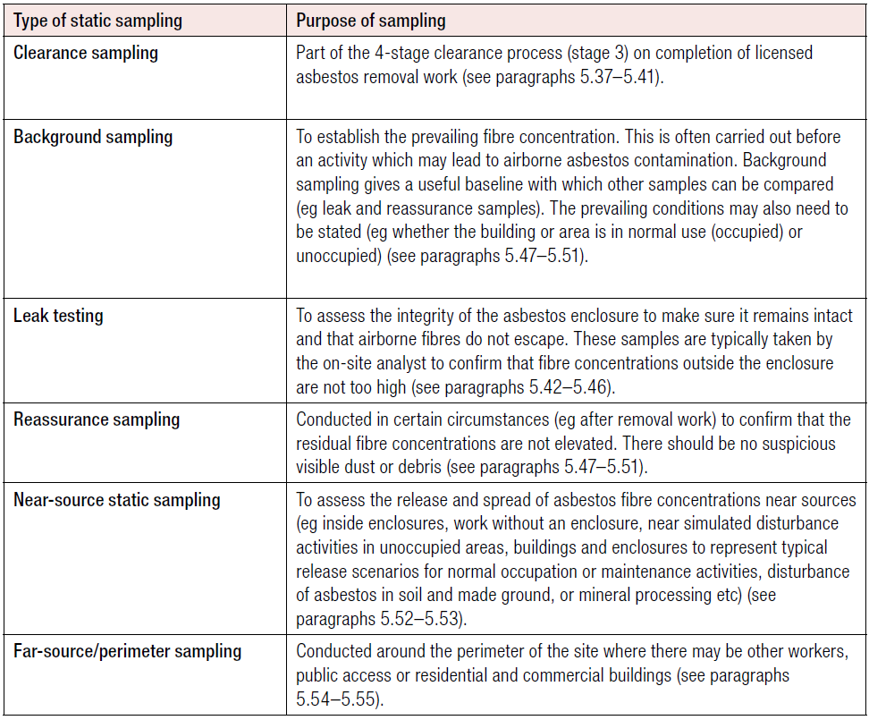
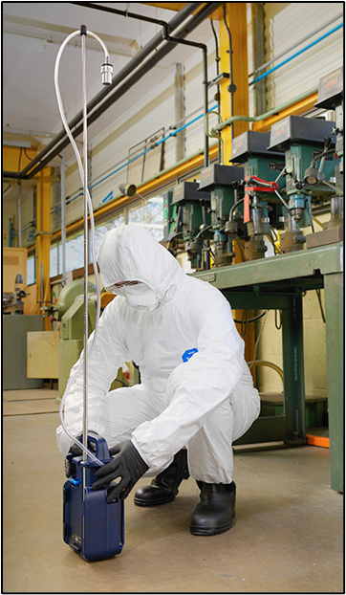
IOM Sampler
Static Sampling
Widely undertaken to asses extent and spread.
Filter 1-2m above floor.
Away from walls or obstructions.

Slide 12
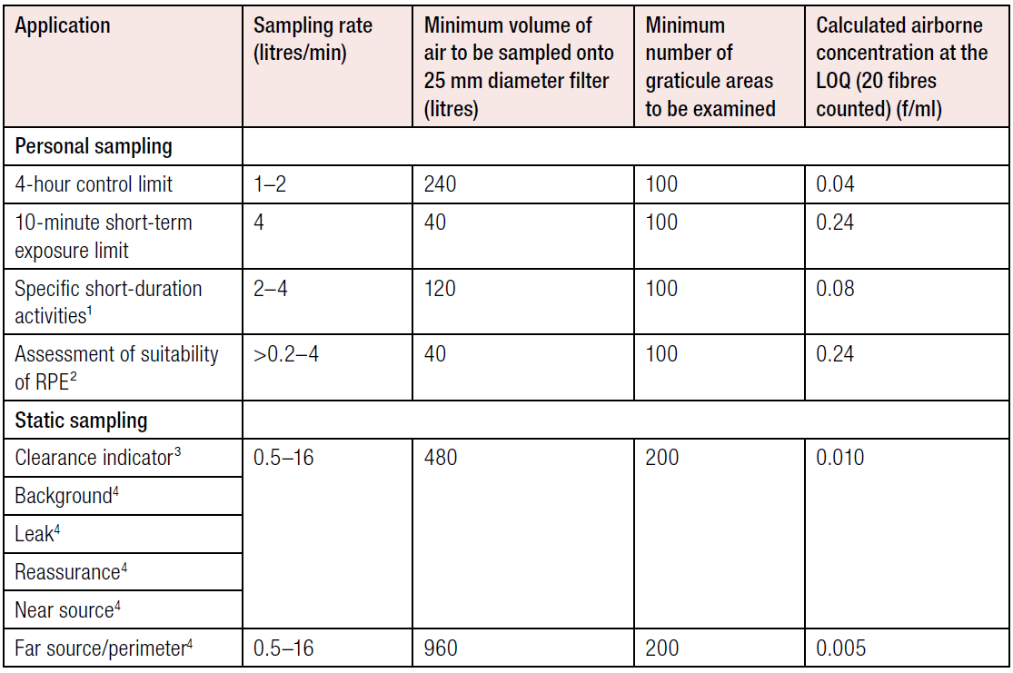
Sampling Regimes HSG248
Although there is no hard and fast rule on room size, there is some element of guidance.
“In larger rooms and outside, samples may be collected at specified distances and directions from the source, to assess the spread or dilution of the emission.”
As an indication it would be prudent to sample a min of 480 l/min.
If an area is particularly clean etc, then HSG248 has a note that up to 2,400 litres can be sampled.
Whats ia afibre?

Slide 13
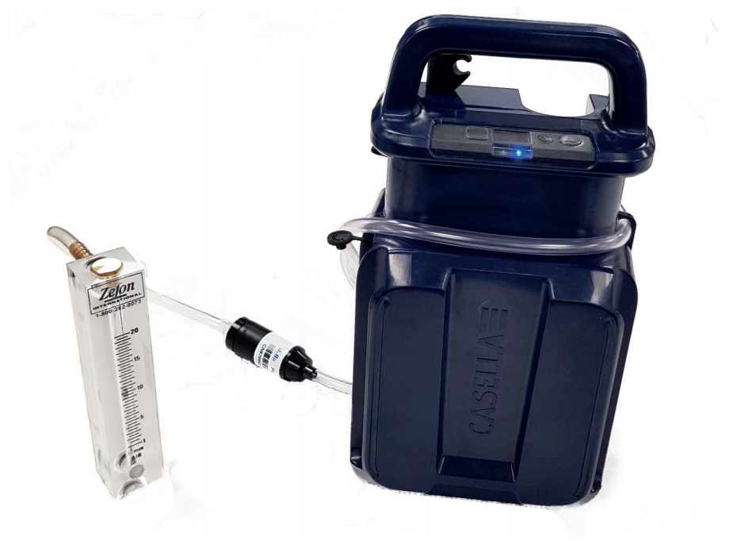
IOM Sampler
Sampling Guide
Before the start:
Check parts for damage
The pump is switched on – warm up
Set flow rate and the time and flow rate recorded
Note sampling location and relevant contextual information
Calibrate the pump
Suitable flow meter
Whole sample train

Slide 14
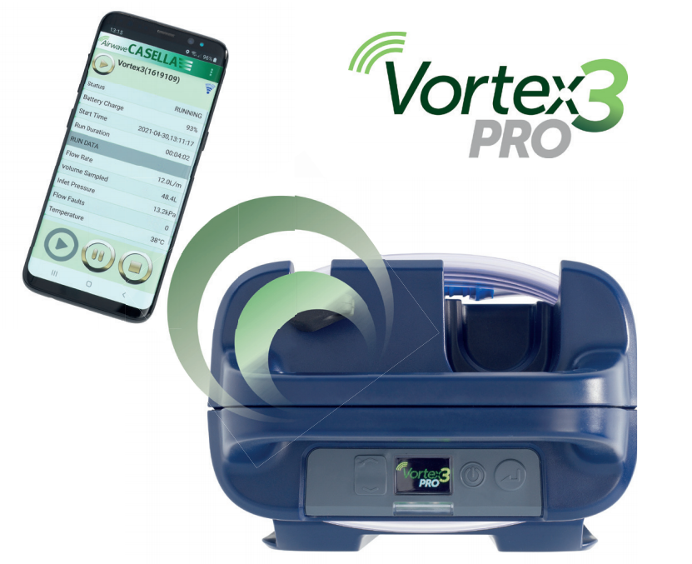
IOM Sampler
Sampling Guide
During the sampling period
Periodic checking – record.
Check for overloading – back pressure/remote?
After the sampling period
Check flow rate and record.
Record anything of note e.g. time.
Check for damage/battery condition.

Slide 15
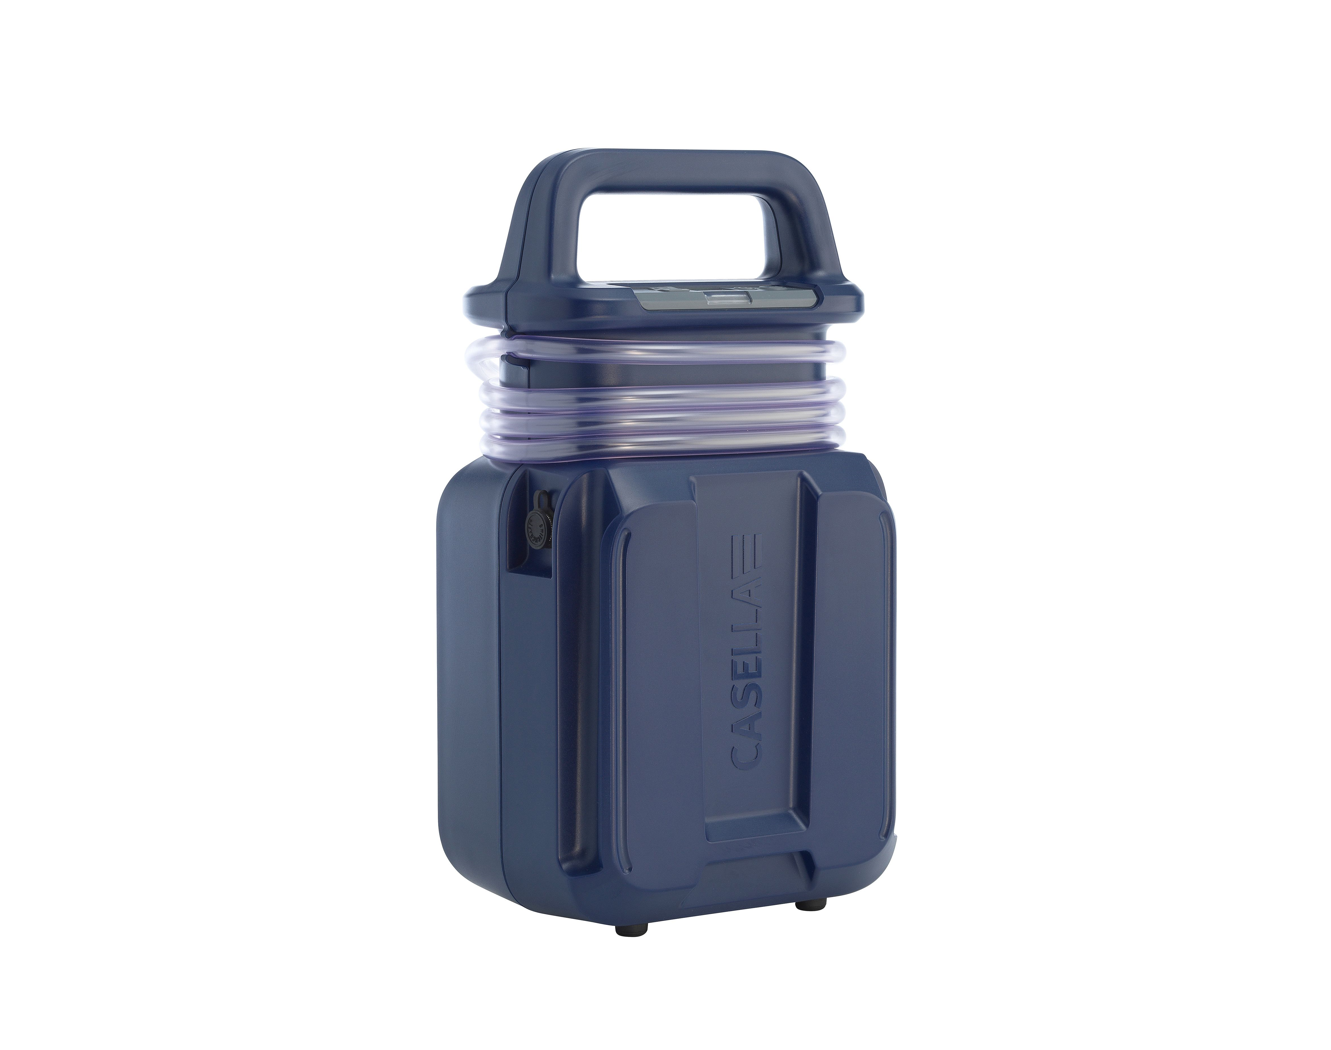
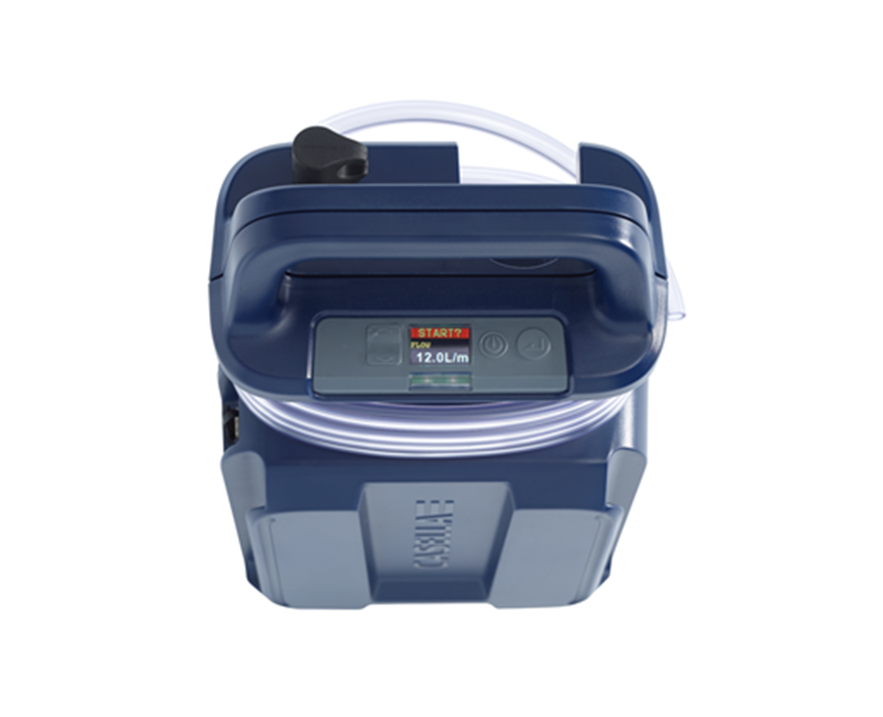

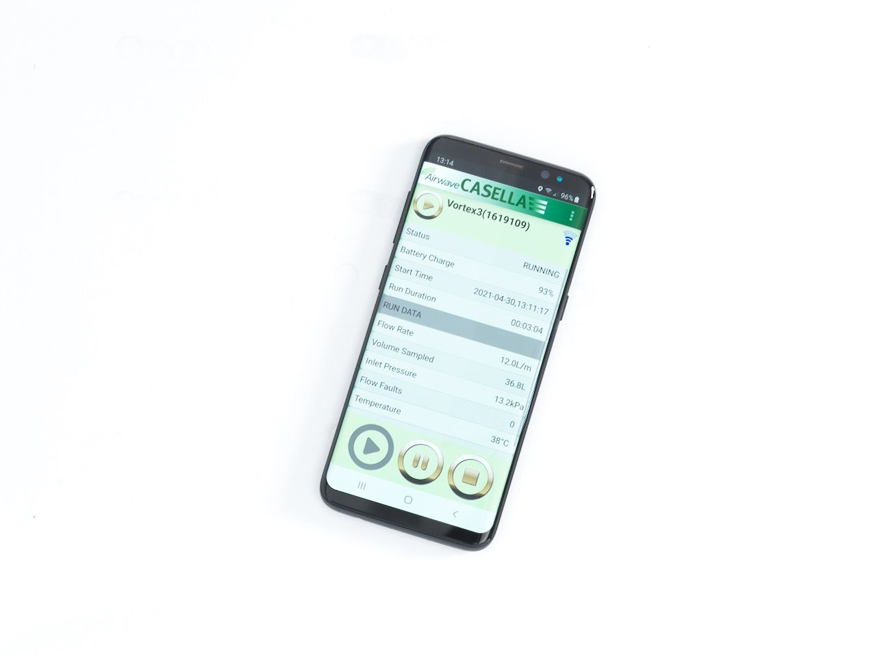

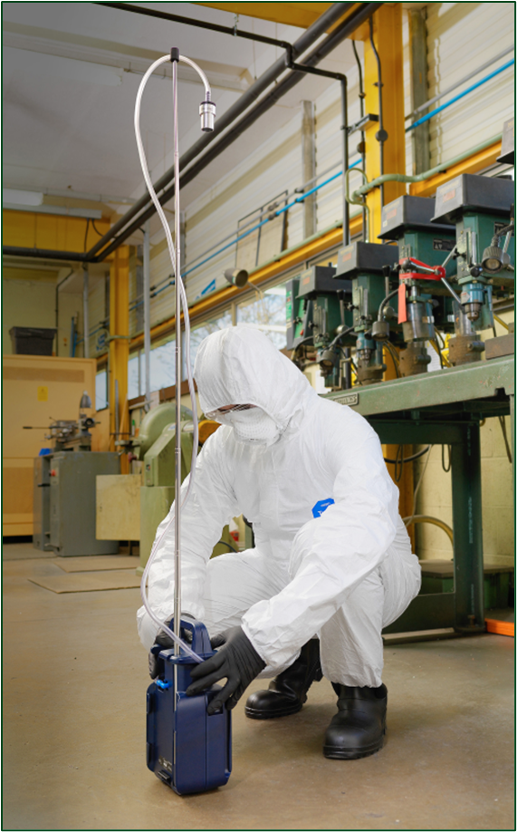
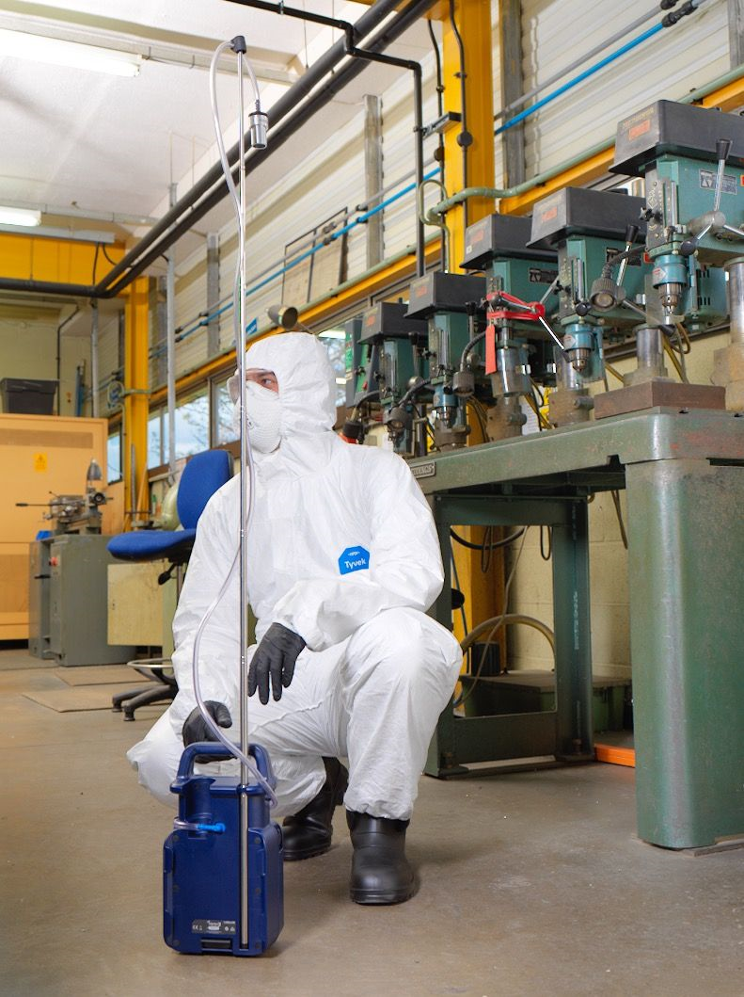
Vortex3 – Meeting the application challenges
A High Flow Air Sampling Pump to meet the challenges of Asbestos/ Hazardous Substance Area Air Sampling without Compromise
Rugged design, comfortable handle and robust enough to meet the application challenges
Simple to use, easy to read intuitive user interface with only 4 buttons
Interlocking connecting mechanism that enables 3/ 4 pumps to be carried at one time
or Icon
Vortex3 connectivity with the Airwave App, sampling data at your fingertips
IP65 making the Vortex3 easy to clean, decontaminate and look after
High performance – 8Hr runtime @ 12 L/min using a 25mm 0.8um filter – Flow accuracy better than +/- 5%

Slide 16
HSE’s Next move
Late 2025 Consultation
Three proposals
To ensure the independence and impartiality of roles in the four-stage clearance process to further minimise the risk of exposure from asbestos to workers and building users after the removal of asbestos.
To drive up the standard of asbestos surveys to ensure duty holders have the information they need to safely manage asbestos risks.
To clarify the type of work that constitutes work with asbestos known as Notifiable Non-Licensed Work (NNLW).

Slide 17

Questions
Stephensandford@casellasolutions.co.uk

